Slide 1
Is Clean Hydrogen Production a Good Fit for Questa?
Intermediate Feasibility Study Results
August 17, 2023
Kevin Topolski, Elaine Hale, Chrissy Scarpitti, Haider Niaz, Andre Fernandes Tomon Avelino, Alberto Franco
National Renewable Energy Laboratory
Notes:
Presenter: Kayla
Why this meeting is occurring –The two hypothetical facilities that will be discussed are being explored by a coalition of community representatives. We are here today to learn and listen. We will discuss future decision-making points and how you can stay involved.

Slide 2
Agenda (2 hours)
Introductions
Questa Context and Project History
Clean Hydrogen Concepts/Hydrogen Overview
Two Potential Clean Hydrogen Facilities for Questa
Concerns about Clean Hydrogen
Next Steps
Questions and Answers (throughout)
Links to published presentations
Taos
Is clean hydrogen production a good fit for Questa? Project Introduction. https://www.nrel.gov/docs/fy23osti/84348.pdf
Is clean hydrogen production a good fit for Questa? Intermediate feasibility study results. https://www.nrel.gov/docs/fy23osti/86665.pdf
Notes:
Kayla

Slide 3
Questa Coalition
John Ortega
Mayor, Village of Questa
Luis Reyes
CEO and General Manager, KCEC
Lynn Skall
Director, Questa Economic Development Fund
Gabriel Herrera
Public Affairs Advisor, Chevron
Notes:
Coalition introduces themselves

Slide 4
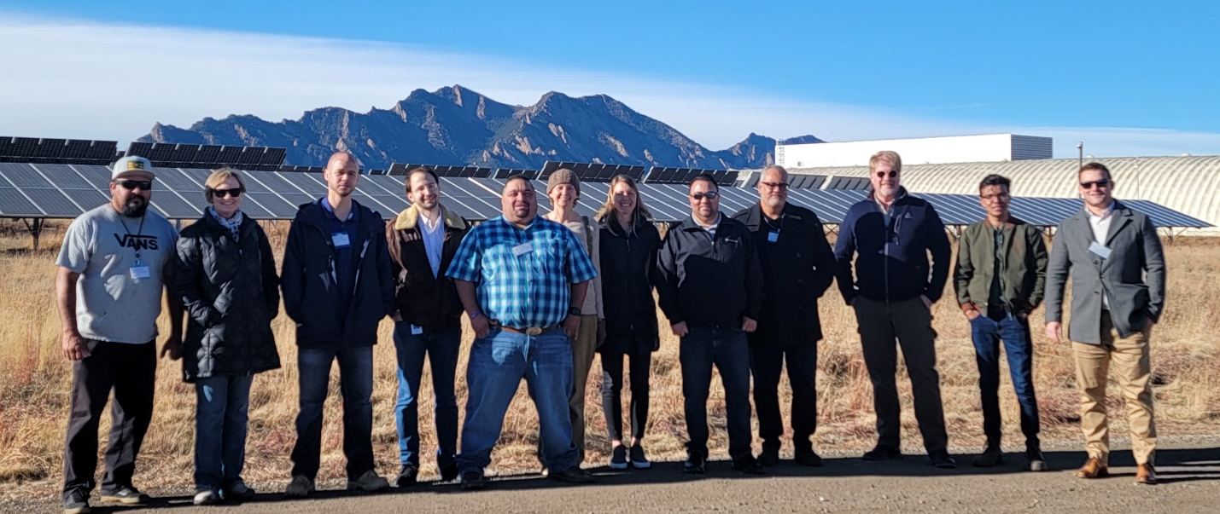
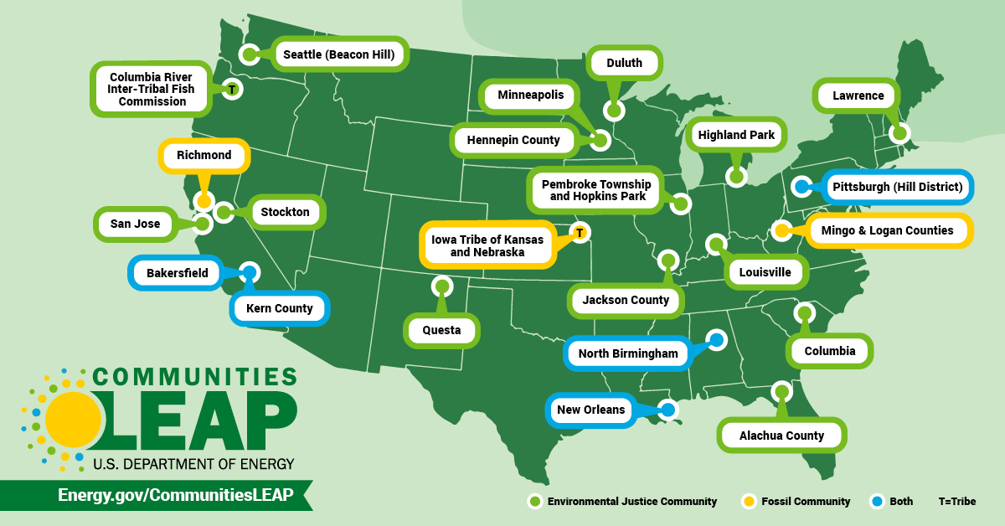
Project Context and History: Why Hydrogen? And How Did We Get Here?
Kit Carson Electric Cooperative (KCEC) exploring alternatives to meet its membership-driven 100% renewable energy goals.
Hydrogen may balance renewable power demand and supply.
New Mexico legal mandate for rural co-ops to transition to carbon-free electricity by 2050.
Questa Community Coalition members see potential economic development and brownfield reuse benefits.
The Communities Local Energy Action Program (LEAP) pilot provides tailored research and analysis services to communities that are low-income, energy-burdened, experiencing environmental justice impacts, or experiencing a shift away from economic reliance on fossil fuels
This coalition applied to study the feasibility and potential impacts of clean hydrogen development in Questa.
Questa is one of the 24 communities selected for the inaugural class of Communities LEAP projects.
Questa LEAP Coalition members and NREL team visit the hydrogen test bed facility at the Flat Irons campus in Boulder County on December 9th, 2022. Photo by Ryan Weeks, NREL
Map of communities participating in the LEAP Pilot. Illustration by DOE
Notes:
John
Kit Carson Electric Cooperative (KCEC) exploring alternatives to meet its membership-driven 100% renewable energy goals.
Hydrogen may balance renewable power demand and supply.
New Mexico legal mandate for rural co-ops to transition to carbon-free electricity by 2050.
Questa Community Coalition members see potential economic development and brownfield reuse benefits.
The Communities Local Energy Action Program (LEAP) pilot provides tailored research and analysis services to communities that are low-income, energy-burdened, experiencing environmental justice impacts, or experiencing a shift away from economic reliance on fossil fuels
This coalition applied to study the feasibility and potential impacts of clean hydrogen development in Questa.
Questa is one of the 24 communities selected for the inaugural class of Communities LEAP projects.

Slide 5
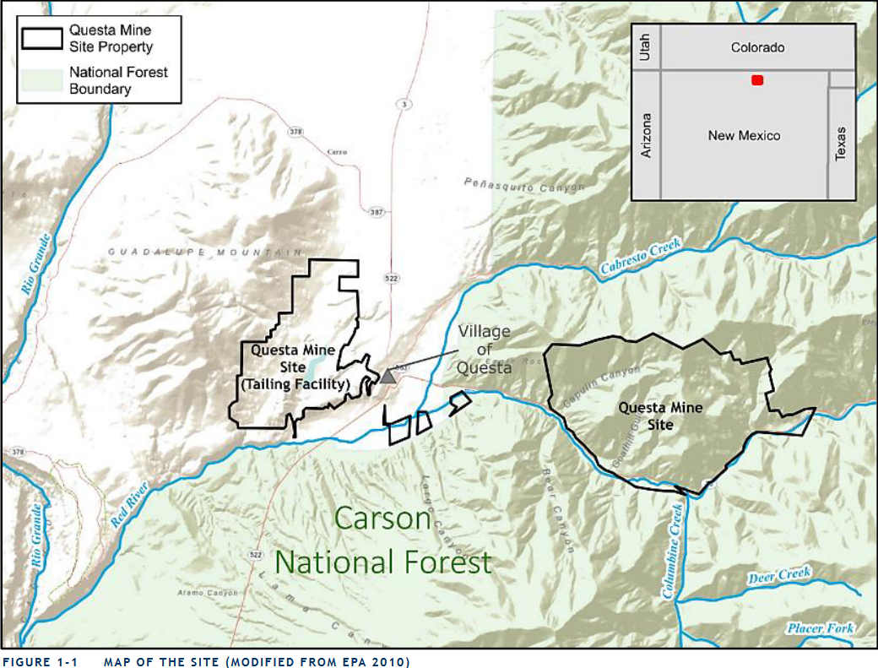
Questa’s Communities LEAP Application
What?
Study whether it would be beneficial to reuse mine and local resources (i.e., land, water) to produce electrolytic hydrogen.
Why?
Deliver clean, reliable electricity during non-solar times (KCEC)
Create jobs in Questa (Village of Questa, Chevron)
Attract more economic activity (Village of Questa, Chevron)
Increase tax base (Village of Questa)
Put existing assets to beneficial use (Chevron)
Maintain affordable energy bills during the transition to clean electricity (KCEC, Village of Questa)
Support corporate carbon reduction goals (Chevron)
Be a replicable model for other rural and tribal communities (KCEC, Village of Questa).
Map of former molybdenum mine site and tailings facility located in Questa, New Mexico. Map by EPA https://onrt.env.nm.gov/wp-content/uploads/2018/05/Final-Questa_RPEA_5.21.18.pdf.
KCEC is looking beyond their 100% daytime solar goal.
Kit Carson Electric Coop (KCEC) solar panels generate daytime power. Photo by KCEC https://kitcarson.com/electric/100-daytime-solar-energy-by-2022/.
Notes:
John
What?
Study whether it would be beneficial to reuse mine and local resources (i.e., land, water) to produce electrolytic hydrogen.
Why?
Deliver clean, reliable electricity during non-solar times (KCEC)
Create jobs in Questa (Village of Questa, Chevron)
Attract more economic activity (Village of Questa, Chevron)
Increase tax base (Village of Questa)
Put existing assets to beneficial use (Chevron)
Maintain affordable energy bills during the transition to clean electricity (KCEC, Village of Questa)
Support corporate carbon reduction goals (Chevron)
Be a replicable model for other rural and tribal communities (KCEC, Village of Questa).

Slide 6
Technical Assistance Team
Kevin Topolski
Hydrogen Infrastructure Analyst, NREL
Elaine Hale
Community Lead, NREL
Chrissy Scarpitti
Community Lead, NREL
Kayla Copeland
Facilitator, Sundance
Andre Avelino
Financial Analyst, NREL
Alberto Solis
Financial Analyst, NREL
Haider Niaz
Post Doc, NREL
Riley Wittler
Facilitator, Sundance
Notes:
NREL/Sundance introduces themselves – Kayla introduces Riley, Chrissy introduces self and role, passes to Kevin, passes to Elaine, Elaine introduces other team members and passes back to Chrissy
My name is Chrissy Scarpitti. I am researcher at the National Renewable Energy Laboratory, known as NREL, located in Denver/Golden colorado.
We are one of 17 research laboratories funded primarily by the Department of Energy.
Our role in this project is to provide an independent scientific assessment of two potential hydrogen production facilities that would be located in Questa.
My role on the NREL team is cordinating the overall technical assistance effort with my colleague, Eliane Hale.
I also lived in Santa Fe from 2008 to 2020.
With that, I will pass it to Elaine.
Elaine - Community Co-lead, research in Grid Planning and Analysis Center, been at NREL 15 years

Slide 7
Questa's Communities LEAP Timeline
Technical Assistance
Begins
Clean Hydrogen Feasibility
Complete
Economic Impact
and Workforce Plan Complete
Technical Assistance
Complete
Fall 2022
Spring 2023
Summer 2023
Fall 2023
01
02
03
04
2022
Technical Assistance
2023
Implementation
2024
Public Engagement
Oct. 22, 2022
KCEC Board/VoQ
Council Meeting*
Jan. 2023
KCEC Board approves project scoping, grant writing, etc.
Potential Partners And
Regulators
Key
Stakeholders
Special Interests Groups
Public Survey and Meetings
ED: NM Environment Department
EDD: NM Economic Development Department
EMNRD: NM Energy, Minerals and Natural Resources Department
LANL: Los Alamos National Laboratory
LOECC: Land of Enchantment Clean Cities
NMSU: New Mexico State University
RETA: New Mexico Renewable Energy Transmission Authority
WISHH: Western Interstate Hydrogen Hub
BLM: Bureau of Land Management
State Legislators
KCEC: Kit Carson Electric Cooperative Board
VoQ: Village of Questa Council
Taos County Commissioners
State Engineer
New Energy Economy
Western Environmental Law Center
Rio Grande Sierra Club
Renewable Taos
350.Org New Mexico
Amigos Bravos
Questa Independent School District
VFW: Veterans of Foreign Wars
Note: Others invited but did not attend.
Groups consulted to date
Notes:
Chrissy
The Coalition is receiving 18 months of research and outreach, free of charge, provided by the DOE
Beginning with scoping in the summer of 2022 and wrapping up in the fall of 2023.
The scope includes a technical feasibility study, economic impacts assessment, and public engagement
Engagement began in October 2022 with KCEC/VoQ meetings, followed by
January 2023 - small group discussions with regulators, key stakeholders, and special interest groups.
The aim of public engagement is to share best available information regarding green hydrogen and listen to the concerns and interests of community members.
The slide deck presented at the October, 2022 meeting can be found online, along with a published version of today’s slide deck.

Slide 8
Disclaimer
Work authored by the National Renewable Energy Laboratory (NREL) for the Department of Energy (DOE) for the Communities LEAP (Local Energy Action Program) Pilot.
Contains clean hydrogen production technoeconomic feasibility study results
Should not be sole basis of investment decisions
Additional analysis required to estimate economic impacts
Additional details available in the published version of this slide deck at https://www.energy.gov/communitiesLEAP/questa-new-mexico.
The purpose of this presentation and the overall study is to provide information to the Questa Community Coalition. The authors, NREL, DOE, and Communities LEAP are not recommending any specific course of action.
Notes:
Chrissy
The intent of this analysis is to begin exploring what clean hydrogen could potentially be like in Questa. We will talk about:
how it would be used,
what it might look like,
where it could be located,
what it might cost, and
what some benefits and concerns might be.
The feasibility results we will share are intended to be used by the coalition and community members, but should not be the sole basis for future decision making.
Additional analysis will be required to estimate economic impacts and study financial models.
NREL is providing this analysis free of charge, thanks to a grant from the DOE.
We are not recommending any specific course of action

Slide 9
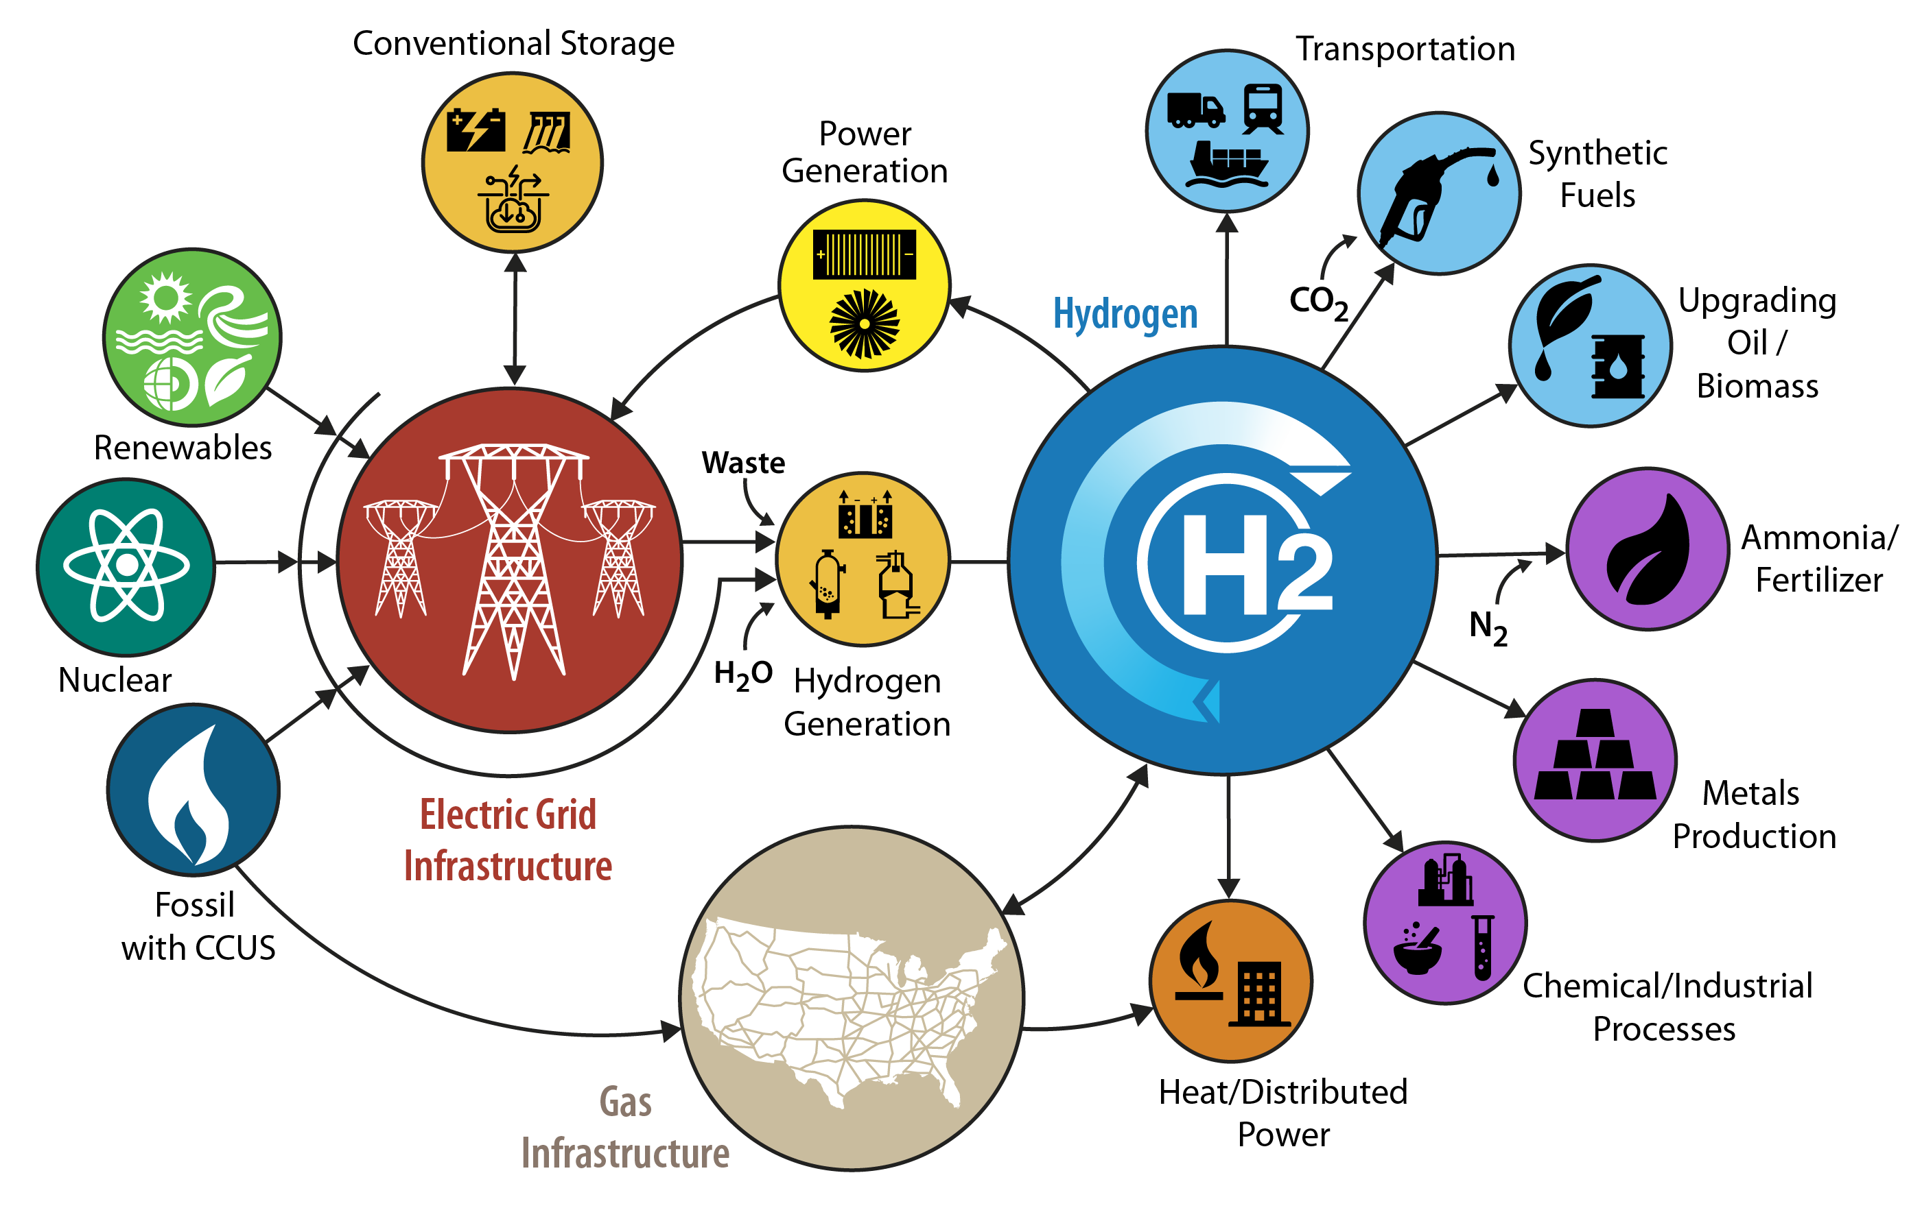
What Is Hydrogen (H₂)?
How hydrogen is produced:
Renewable electricity by electrolysis (or ”Green H₂”)
Natural gas by reforming:
without carbon capture (or “Gray H₂”)
with carbon capture (or “Blue H₂”).
Coal gasification (or “Black H₂”).
How hydrogen is used:
Vehicle fueling
Electricity generation
Other uses, as shown in Figure 1.
Applications of interest for Questa
Figure 1. Various uses of hydrogen
Notes:
Kevin (8 mins)
In this presentation, we will focus on hydrogen, what it is, how to make it, what is it used for and what this may mean for Questa
(Hydrogen production) is an energy-carrying gaseous molecule that can be produced in multiple ways—for example, from:
Renewable electricity by electrolysis (or ”Green H₂”)
Natural gas by reforming:
without carbon capture (or “Gray H₂”)
with carbon capture (or “Blue H₂”).
Coal gasification (or “Black H₂”).
In this presentation, we will focus on ”Green H2” which could also be referred as Clean H2
(Hydrogen consumption) Hydrogen could be a clean alternative to methane (CH₄), also known as natural gas, because H₂ is a fuel that can be used for multiple purposes similar to methane [1]:
Vehicle fueling
Electricity generation
Other uses, as shown in Figure 1

Slide 10
How Is Clean Hydrogen Made? How Is It Used?
For General Reference
10 kWh = Running AC for 2 hrs.
1 kg H₂ = 1 gallon (gal) Diesel Fuel
Legend
= 1 gal
= 10 kWh
H₂
= 1 kg of H₂
Electrolyzer
Fuel Cell
3.8 gal
Vented oxygen (and water)
Electricity
20 kWh
Water
-
+
Air Intake
Hydrogen
55 kWh
Fuel Cell Exhaust
(air and water vapor)
H₂
1 kg of Hydrogen
1 kg of Hydrogen
H₂
Electricity
O₂
H₂
0.2 gal
Water
Water Electrolyzer
Fuel cell
Electricity is used to split water (H₂O) into oxygen (O₂) and hydrogen (H₂).
Hydrogen (H₂) is ionized and then combined with oxygen (O₂) to produce electricity and water vapor.
Notes:
Kevin
In this slide, we show how a kg of clean H2 is mad and used.
This project focuses on clean H₂ production by electrolysis.
Virtually no CO₂ emissions or criteria air pollutants are created from electrolytic H₂ production.
Can be powered by any form of clean electricity production (wind, solar, and/or nuclear).
Clean H₂ could be used in fuel cells for grid power or vehicle mobility.
No CO₂ emissions or criteria air pollutants are created.
Could flexibly provide power when needed (winter peak times with no sun and little wind and vehicle propulsion).

Slide 11
Pause for Questions
Taos
Notes:
Kayla

Slide 12
Potential Hydrogen Facilities for Questa
Notes:
Note for Riley, leave this slide up for Kevin to provide transition
Kevin (15 mins)
During this technical assistance, we investigated two potential facilities of interest to the C-Leap Community Coalition

Slide 13
Facility A: Grid-Connected Energy Storage Application (KCEC)
Planning for 100% Clean, Resilient Electricity
Solar and wind are fundamental technologies
Transmission facilitates clean-energy imports
Complementary technologies
Hydrogen long-term energy storage
Thoughtful deployment can increase resilience
Wind Farm
+
-
+
-
Battery
Hydrogen Facility
Solar Array
Fuel Cell
+
-
Water Tank
O₂
H₂
Storage Tanks
Grid
Water Electrolyzer
Notes:
Kevin
The first facility is applicable to Kit Carson’s Electric Cooperative’s operations where we employ a hydrogen facility to serve like big battery
Where will it be located, what will it do, What benefit does this facility type add?
On-demand power to KCEC grid when no solar or wind. Nighttime. Long duration storage, complimentary to batteries
Grid-tied application may be located on Chevron’s tailing facility (west of Questa). Would require about 105 acres of land, largely for a grid-tied solar pv array, co-located with the hydrogen facility.
Solar and wind are fundamental technologies:
Clean electricity plans, including KCEC’s, start with solar and wind. Solar photovoltaics (PV) arrays are well-accepted in the Taos county area and are being deployed locally.
Transmission facilitates clean-energy imports:
Taos county is more sunny than windy, so KCEC has been exploring how to access wind by building more transmission (from east of the Sangre de Cristo Mts., etc.)
Complementary technologies:
Detailed clean energy plans deploy multiple technologies to complement solar and wind [6]. KCEC is deploying batteries to better align electricity supply with demand.
Hydrogen long-term energy storage:
Detailed clean energy plans also find prolonged periods of low solar and wind availability [6]. Emerging technologies like hydrogen energy storage will be needed to keep the lights on (e.g., after batteries have been discharged).
Thoughtful deployment can increase resilience:
Distributing, for example, solar, battery, and long-term hydrogen storage throughout KCEC territory could provide more power to more people during wildfires and other stressful conditions.

Slide 14
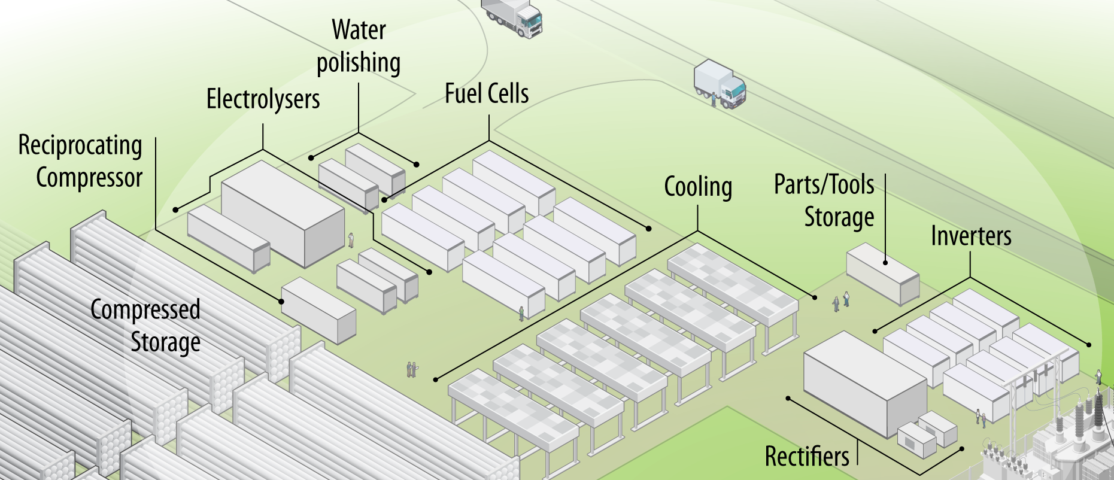
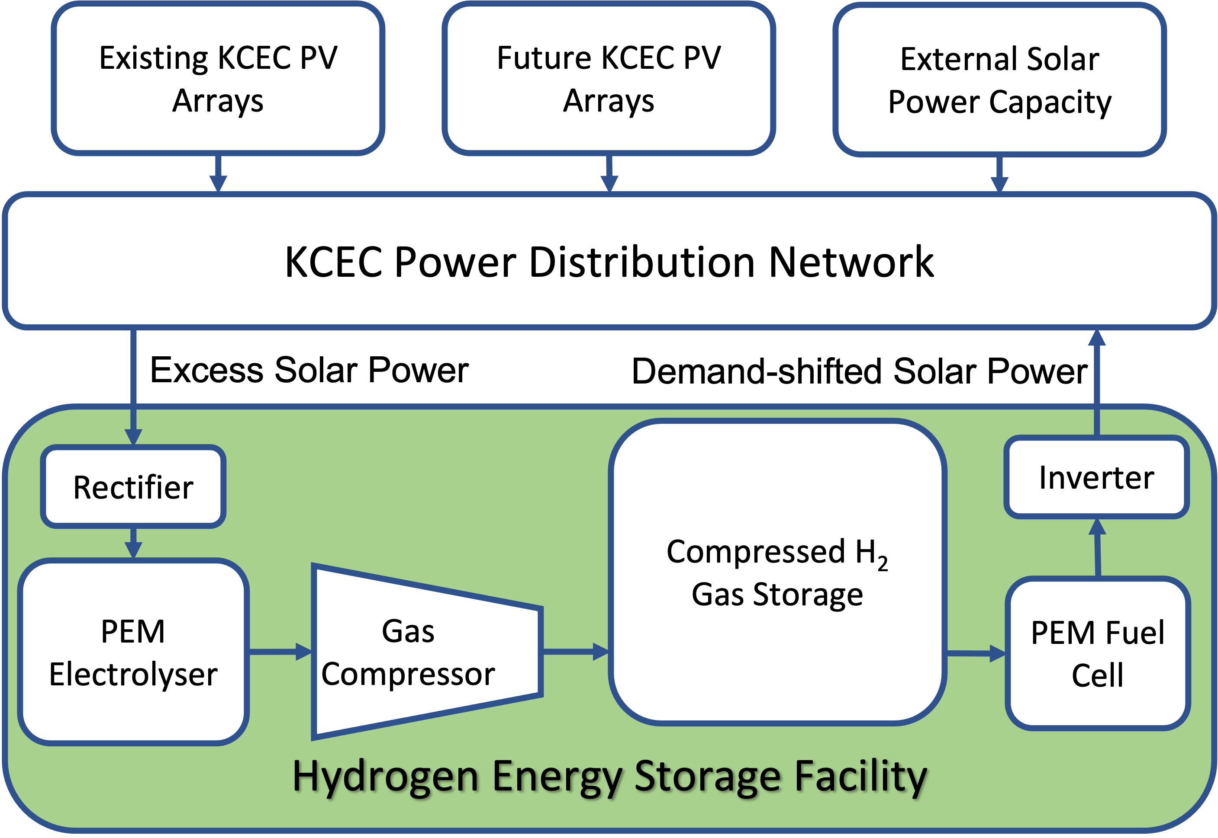
Facility A: Grid-Connected Storage Application
Conceptual Design and Purpose
Application: Long-duration storage facility for the local power network:
Converts solar power in excess of local demand to hydrogen gas via water electrolysis
Stores hydrogen on-site via steel pipe storage
Fuel cell uses stored hydrogen to generate electricity when solar and batteries cannot meet power demand.
Location: Chevron Tailing Facility under consideration
Equipment configuration and size:
32-MW PEM electrolyzer
14-ton compressed hydrogen gas storage
7.5-MW PEM fuel cell
15-MW solar PV array.
Figure 3. Grid-connected storage facility flow diagram
Figure 4. Conceptual rendering. Illustration by Alfred Hicks, NREL
Notes:
Kevin
The equipment in this facility involves…
The location for this facility has not been determined but the Chevron Tailings Facility west of Questa is under consideration
PEM: Polymer Electrolyte Membrane
✢ The feasibility study makes these simple assumptions, but realistic operations will likely be more complex (e.g., produce hydrogen with low-cost electricity [excess local solar or other] and only run the fuel cell if other clean electricity options [including imported wind] are unavailable or very expensive).

Slide 15
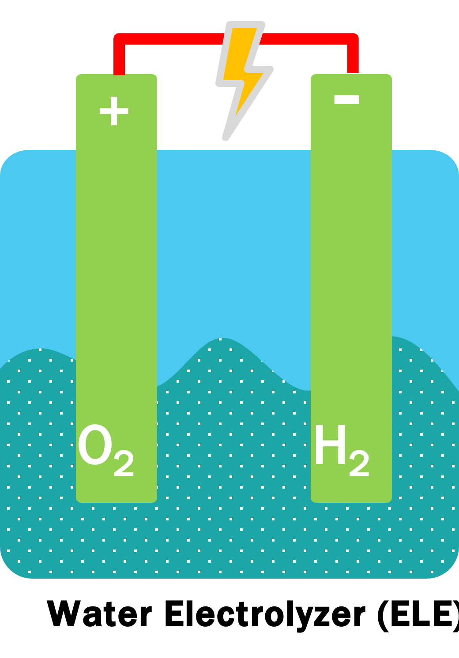
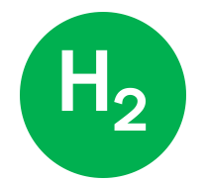
Facility A: Inputs and Outputs
Design Inputs
Design Outputs
Direct Inputs
5.34 acre-ft/yr of water withdrawn (excluding cooling water)
25.9 GWh/yr of solar electricity in excess of local demand
90–105 acres of land for 15 MW of solar PV and H₂ facility
10 permanent jobs.
Indirect Inputs
143–166 acres of land (for additional planned non-collocated 24 MW of KCEC solar capacity).
Direct Outputs
9.0 GWh/yr electricity to directly supply demand
460 tons/yr of H₂ produced and temporarily stored.
0.27 acre-ft/yr of condensed water (for return).
Indirect Outputs
456 metric tons CO₂e/yr avoided
Grid-connected electrolyzer annual summary
Grid-connected fuel cell annual summary
32-MW electrolyzer
5.34 acre-ft of water/year
25.9 GWh/yr of excess electricity
460 metric tons of H₂/year
460 metric tons of H₂/year
7.5-MW Fuel Cell
0.27 acre-ft of water/year
9 GWh/yr of round-tripped electricity
1 acre foot = 1 year of indoor water use for 4 New Mexican households (325,851 gallons)
1 GWh = 1 year of electricity use for 129 New Mexican households (1 million kWh)
Notes:
Kevin
We modeled this facility’s operation over the course of a year to estimate resource inputs and outputs
How much water would it use? Water use of about 55 households for a year.
How much power would it provide? Electricity supply for about 115 households for a year.
Why would it take so many resources to create a little electricity? What benefit comes from this? On-demand power to KCEC grid when no solar or wind. Nighttime.
* This assumes a simple dispatch strategy for KCEC’s local PV, batteries, and hydrogen storage assets, where the electrolyzer is last to charge and the fuel cell is the last to discharge.
✢ Estimate excludes water use for facility cooling. See lessons learned from https://www.nrel.gov/docs/fy23osti/83885.pdf.
** We assume that fuel cell generation avoids emissions at the long-run marginal emission rate for northern New Mexico over the 30-year project lifetime, starting in 2027.

Slide 16
Facility A: Feasibility Results (Pre-Economic Impacts Analysis)
Results
$44.5 MM overnight capital cost (without incentives)
Levelized cost of electricity = $0.45/kWh of round-tripped electricity (with incentives)
Key assumptions:
Projected 2027 technology costs
Full value of Inflation Reduction Act incentives (see below)
Power generation to supply 3.1% of KCEC annual electricity demand during hard-to-serve times
Incentive | Assumed Value | Equipment Covered
IRA PTC | $3/kg H₂ produced | Electrolyzer, Rectifier
IRA ITC | 40% investment tax credit | H₂ Storage, Fuel Cell, Inverter
Notes:
Kevin
We have also estimated the cost to build this facility, keeping in mind federal renewable energy incentives
$44.5 MM overnight capital cost (without incentives)
Levelized cost of electricity = $0.45/kWh of round-tripped electricity (with incentives)
Power generation to supply 3.1% of KCEC annual electricity demand during hard-to-serve times
Key assumptions:
2027 electrolyzer and fuel cell technology costs
Full value of Inflation Reduction Act incentives (below)
Dispatch strategy that maximizes local use of local solar generation (77 MW KCEC new and existing PV)
Projection of 2027 KCEC net load, 2021 PV profiles.
Verbally discuss that LCOE is not direct cost to end user but incorporated into end retail rate, similar to how batteries show up on current bills. Discuss economies of scale

Slide 17
Facility B: H₂ Fuel Cell Vehicle Fueling Application (Chevron)
Reduce Emissions in Support of Corporate Carbon Reduction Goals
Stand-alone solar array, electrolyzer, and hydrogen storage
Hydrogen fueling station
Offset diesel fuel use in mine site remediation
Grid
Hydrogen Facility
Storage Tanks
Compressor
Solar Array
Fuel Cell
Vehicle
+
-
Fueling Station
O₂
H₂
Water Tank
Water Electrolyzer
Notes:
Kevin
The second facility we investigated is for hydrogen fuel vehicle fueling and is relevant to Chevron’s mine operations
Where will fueling station be located, which vehicles, what do the vehicles do?
Vehicle fueling application would likely be located at Chevron’s mine facility (east of Questa up RT38). Would require about 30 acres of land, including an off-grid solar pv array, co-located with the hydrogen facility.
Chevron earth-moving equipment and long-haul trucks are likely consumers.
Stand-alone solar array, electrolyzer, and hydrogen storage: The electricity produced by an off-grid solar array runs an electrolyzer. Hydrogen storage is sized to serve a flat weekly demand despite higher production rates in the summer.
Hydrogen fueling station: The hydrogen storage facility connects to a fueling station that heavy-duty, off-road vehicles visit once per day.
Diesel fuel offset: The heavy-duty, off-road vehicles move rock as part of mine site remediation. Trucks with diesel internal combustion engines are the traditional alternative to hydrogen fuel cell vehicles.
Decrease emissions: Fuel cells do not generate greenhouse gas emissions, nitrous oxides (NO_{x}), or particulate matter that can cause climate change and respiratory illness [7]. Hydrogen combustion engines generate NO_{x} [7], but are not considered in this study.

Slide 18
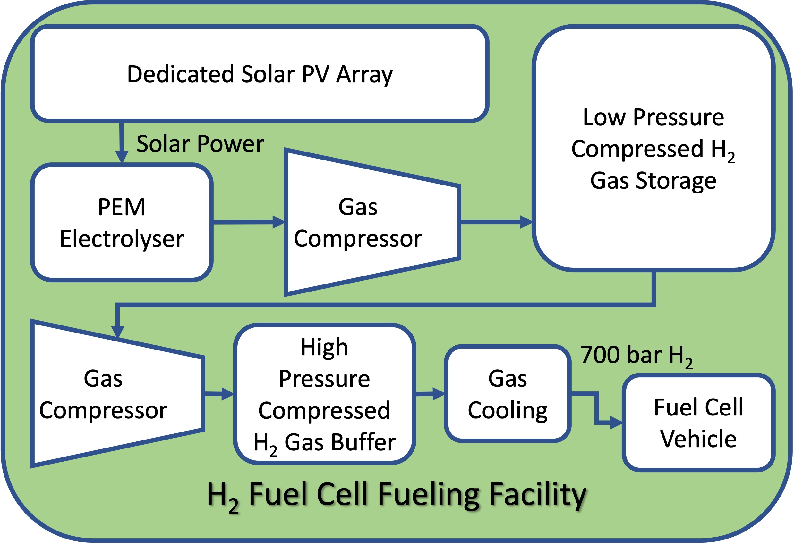
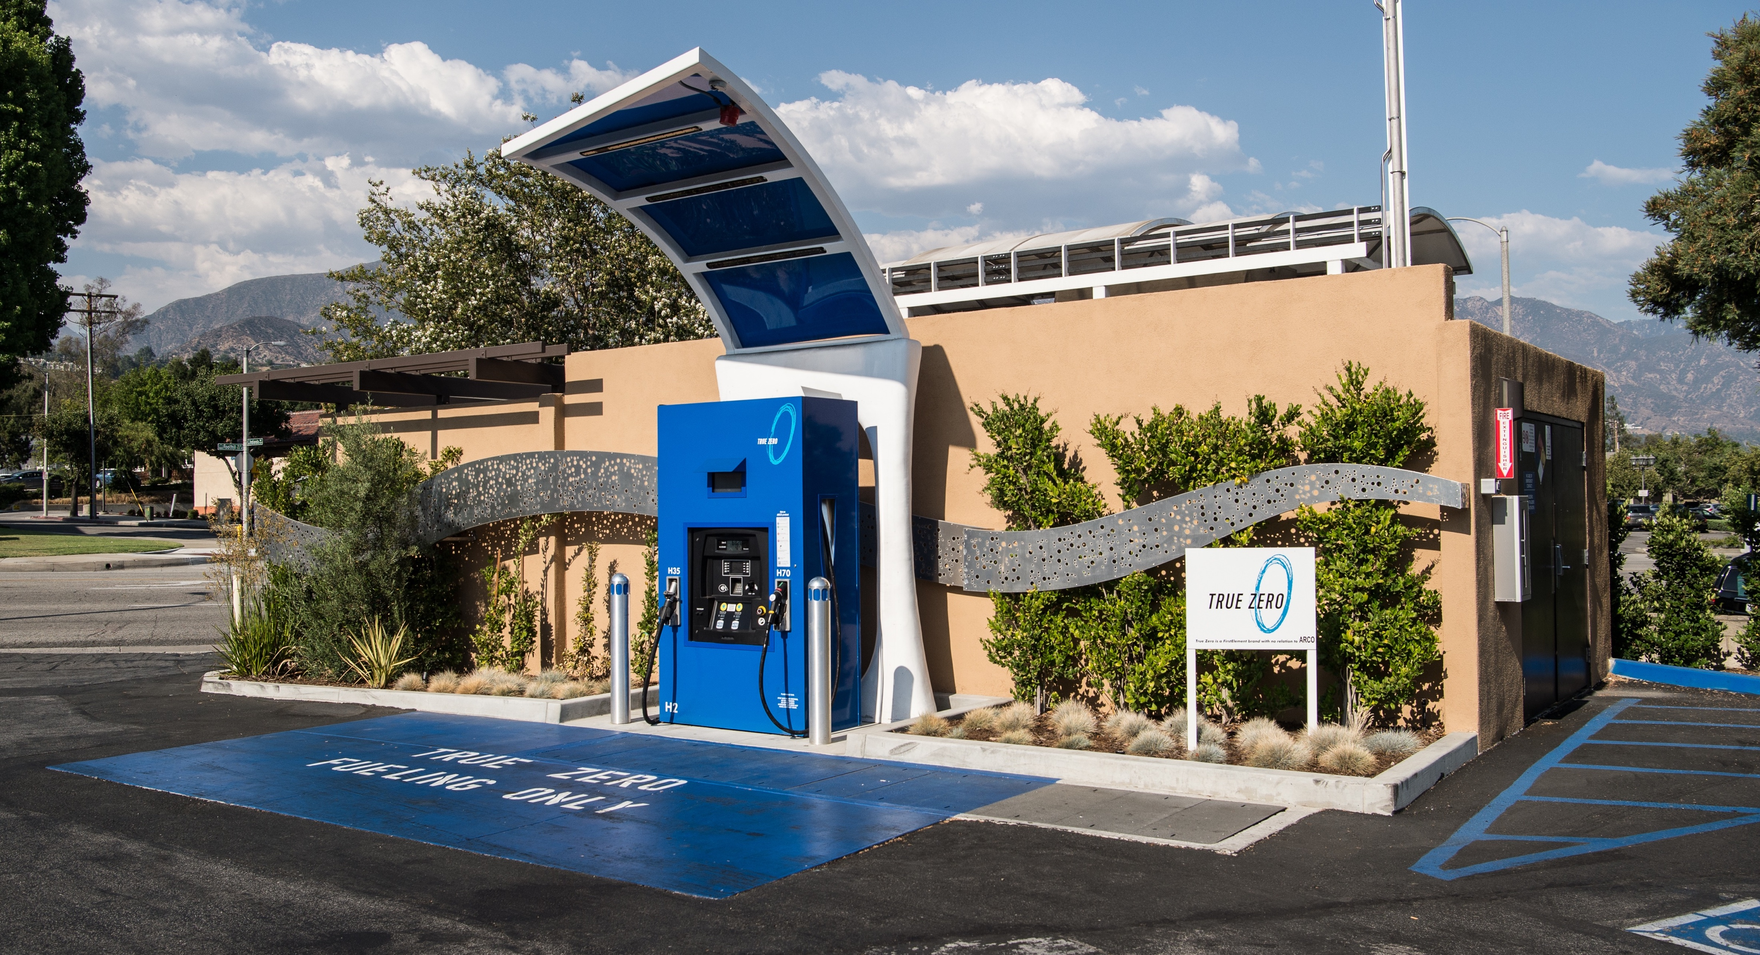
Facility B: H₂ Fuel Cell Vehicle Fueling Application
Conceptual Design and Purpose
Location: Chevron former molybdenum mine site
Equipment configuration and size:
4.2-MW solar PV array
4.2 MW PEM electrolyzer
16.1-ton compressed H₂ gas storage
Hydrogen fuel cell vehicle refueling station.
Application: Heavy-duty fuel cell vehicle fueling facility for Chevron’s mine reclamation operations:
Dedicated solar PV array supplies power to generate hydrogen gas via water electrolysis
Steel pipe storage stores hydrogen on-site
Sizing supports refueling assuming constant daily demand and variable solar generation.*
Figure 5: H₂ fuel cell vehicle fueling facility block flow diagram
Figure 6: Light-duty H₂ fueling facility in La Cañada, CA. Photo by Dennis Schroeder, NREL
Notes:
Kevin
This facility comprises of…
Sizing assumed 2021 weather data (e.g., solar irradiance, temperature), which results in a solar PV capacity factor of 23.8%. If this project is pursued, the sizing should be refined to account for year-to-year solar generation variability and uncertainty.
Potentially located on Chevron mine site, east of Questa up RT 38

Slide 19
Facility B: Inputs and Outputs
Design Inputs
Design Outputs
Direct Inputs
8.72 GWh/yr renewable electricity from solar PV
1.82 acre-ft/yr water withdrawn and consumed (excluding cooling water)
1.25 permanent jobs
25.2–29.4 acres of land (for solar PV siting)
1.11 GWh/yr grid electricity (for fueling station).
Direct Outputs
157 tons/yr of on-demand 700-bar hydrogen gas for heavy- duty fuel cell vehicle refueling.
Indirect Outputs
195,690 gal/yr of diesel use displaced, avoiding:
1,992 metric tons/yr CO₂
17.81 metric tons/yr CO
1.05 metric tons/yr NO_{x}
31 kg/yr PM_{2.5.}
Annual Islanded Electrolyzer Operation
Annual Fueling Station Operation
4.2-MW electrolyzer
1.82 acre-ft/year of water
8.72 GWh/year of dedicated solar power
157 metric tons/year of H₂
157 metric tons/year of H₂
1.1 GWh/year of local grid power
700-bar H₂ fueling station
Heavy-duty fuel cell vehicle operation
1 acre foot = 1 year of indoor water use for 4 New Mexican households (325,851 gallons)
1 metric ton H₂ = 1,250 gallons of diesel fuel
Notes:
Kevin
Like the first facility, we modeled Facility B’s operation for a year to determine inputs and outputs
✢ Estimate excludes water use for facility cooling. See lessons learned from https://www.nrel.gov/docs/fy23osti/83885.pdf.
* The H₂ fueling station has an electricity demand to compress H₂ for vehicle fueling. This electricity demand may not align with solar power generation. We therefore assume local grid support.
** Avoided emissions does not account for grid-emissions from powering fueling station

Slide 20
Facility B: Feasibility Results (Pre-Economic Impacts Analysis)
Results
$18.9 MM overnight capital cost (without incentives)
Levelized cost of hydrogen = $4.77/kg of 700 bar H₂ ($3.82/gal diesel equiv., with incentives)
Key assumptions:
Projected 2027 technology costs
Full value of Inflation Reduction Act incentives (below)
Fueling capacity to support Chevron’s reclamation efforts at the former molybdenum mine site
Incentive | Assumed Value | Equipment Covered
IRA PTC | $3/kg H₂ produced | Electrolyzer, Rectifier
IRA ITC | 40% investment tax credit | H₂ Storage
Notes:
Kevin
The cost to build this facility and it’s cost to produce hydrogen for refueling is shown here
$18.9 MM overnight capital cost (without incentives)
Levelized cost of hydrogen = $4.77/kg of 700 bar H₂ ($3.82/gal diesel equiv., with incentives)
Fueling capacity to support Chevron’s reclamation efforts at the former molybdenum mine site
Key assumptions:
2027 electrolyzer technology costs
Full value of Inflation Reduction Act incentives (below)
Constant hydrogen demand throughout the year, 23.8% capacity factor (2021 weather) for solar PV.

Slide 21
Pause for Questions
Taos
Notes:
Kayla

Slide 22
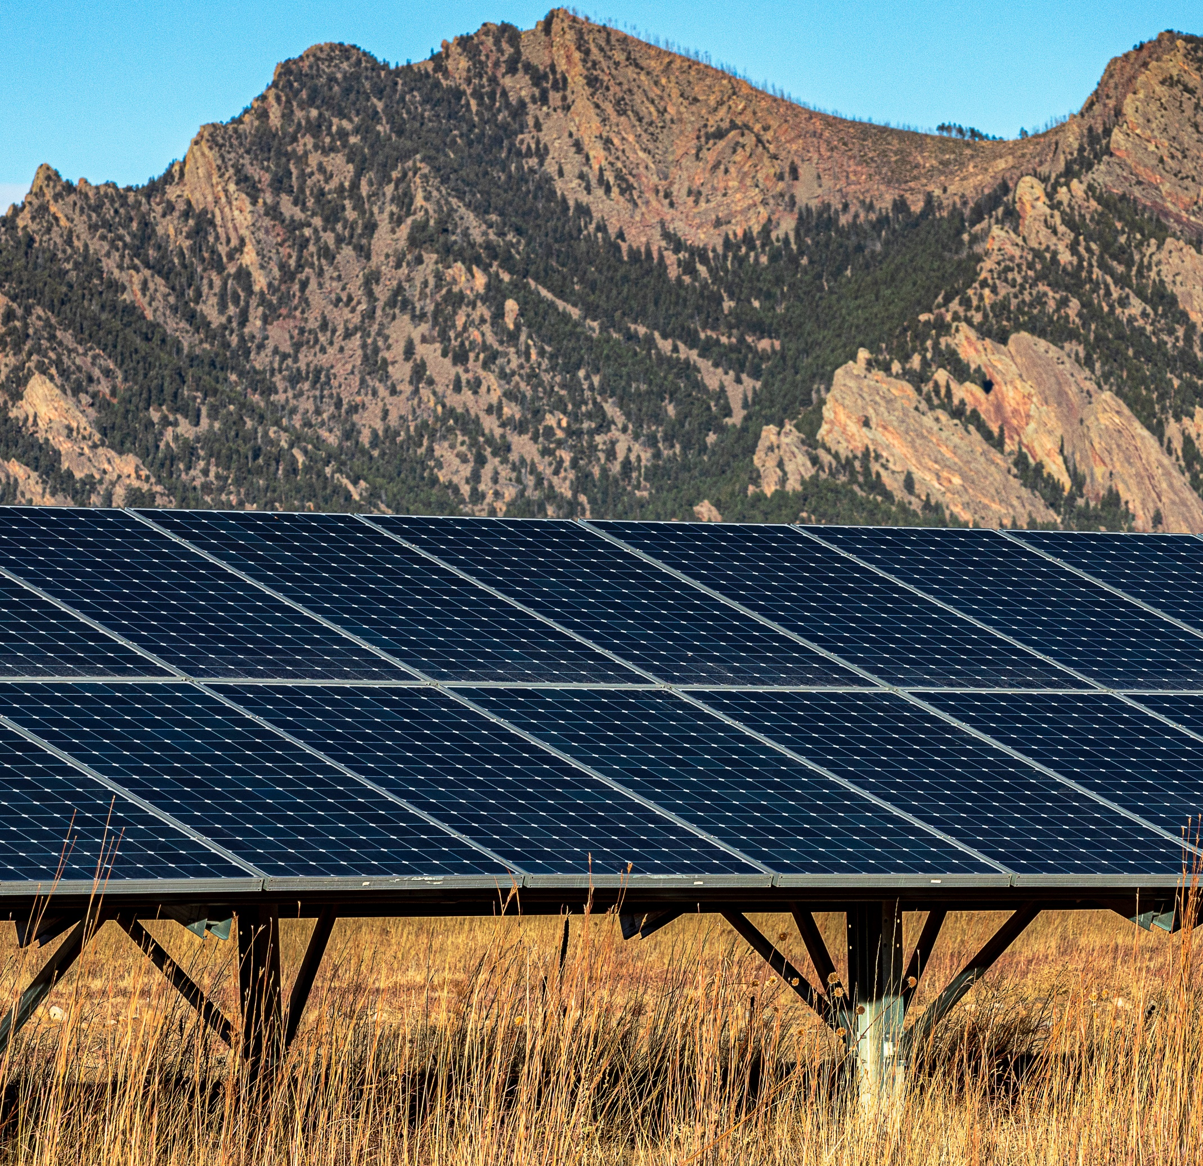
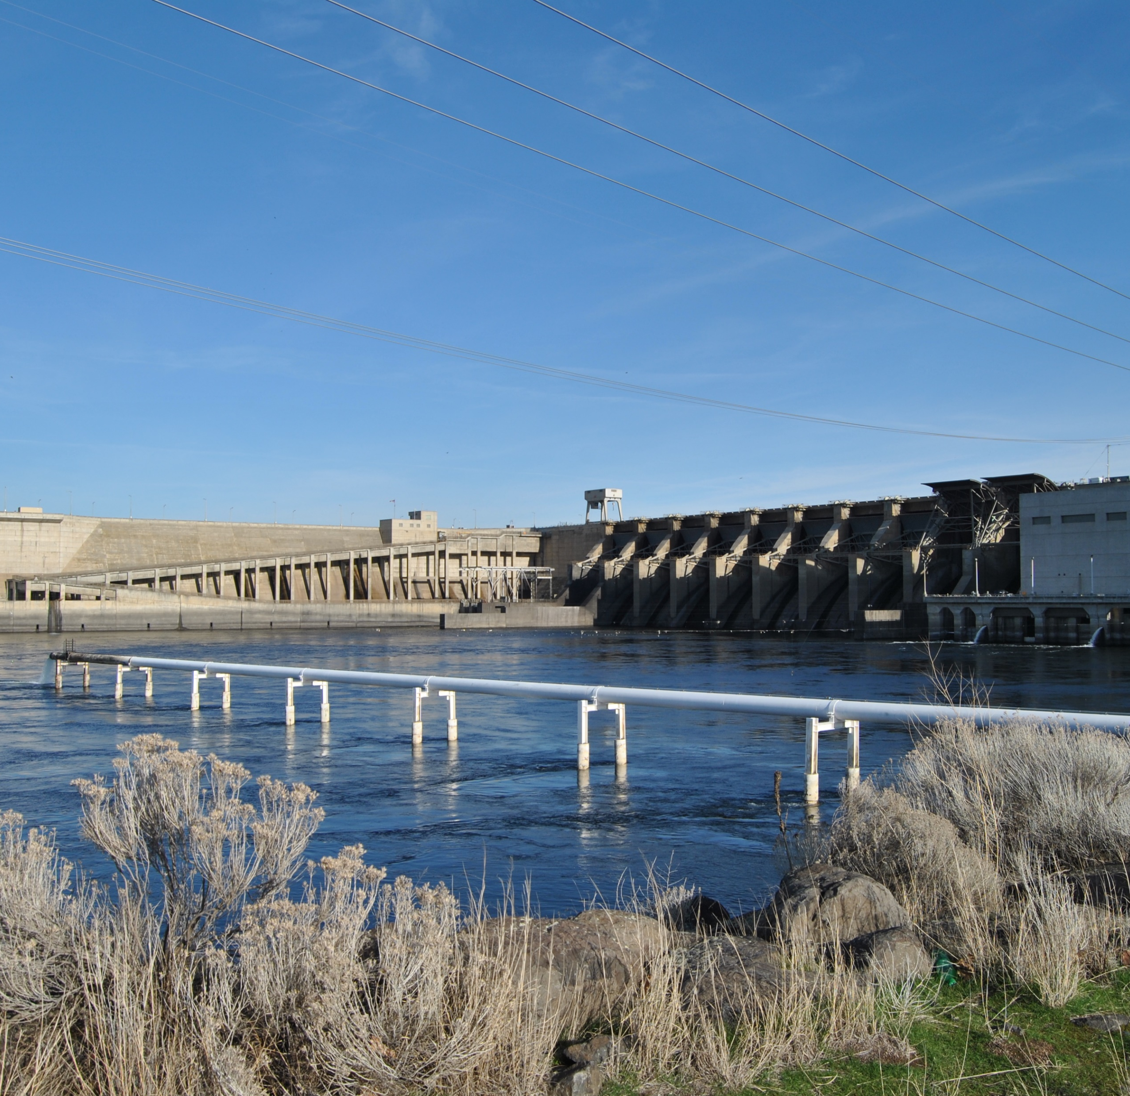
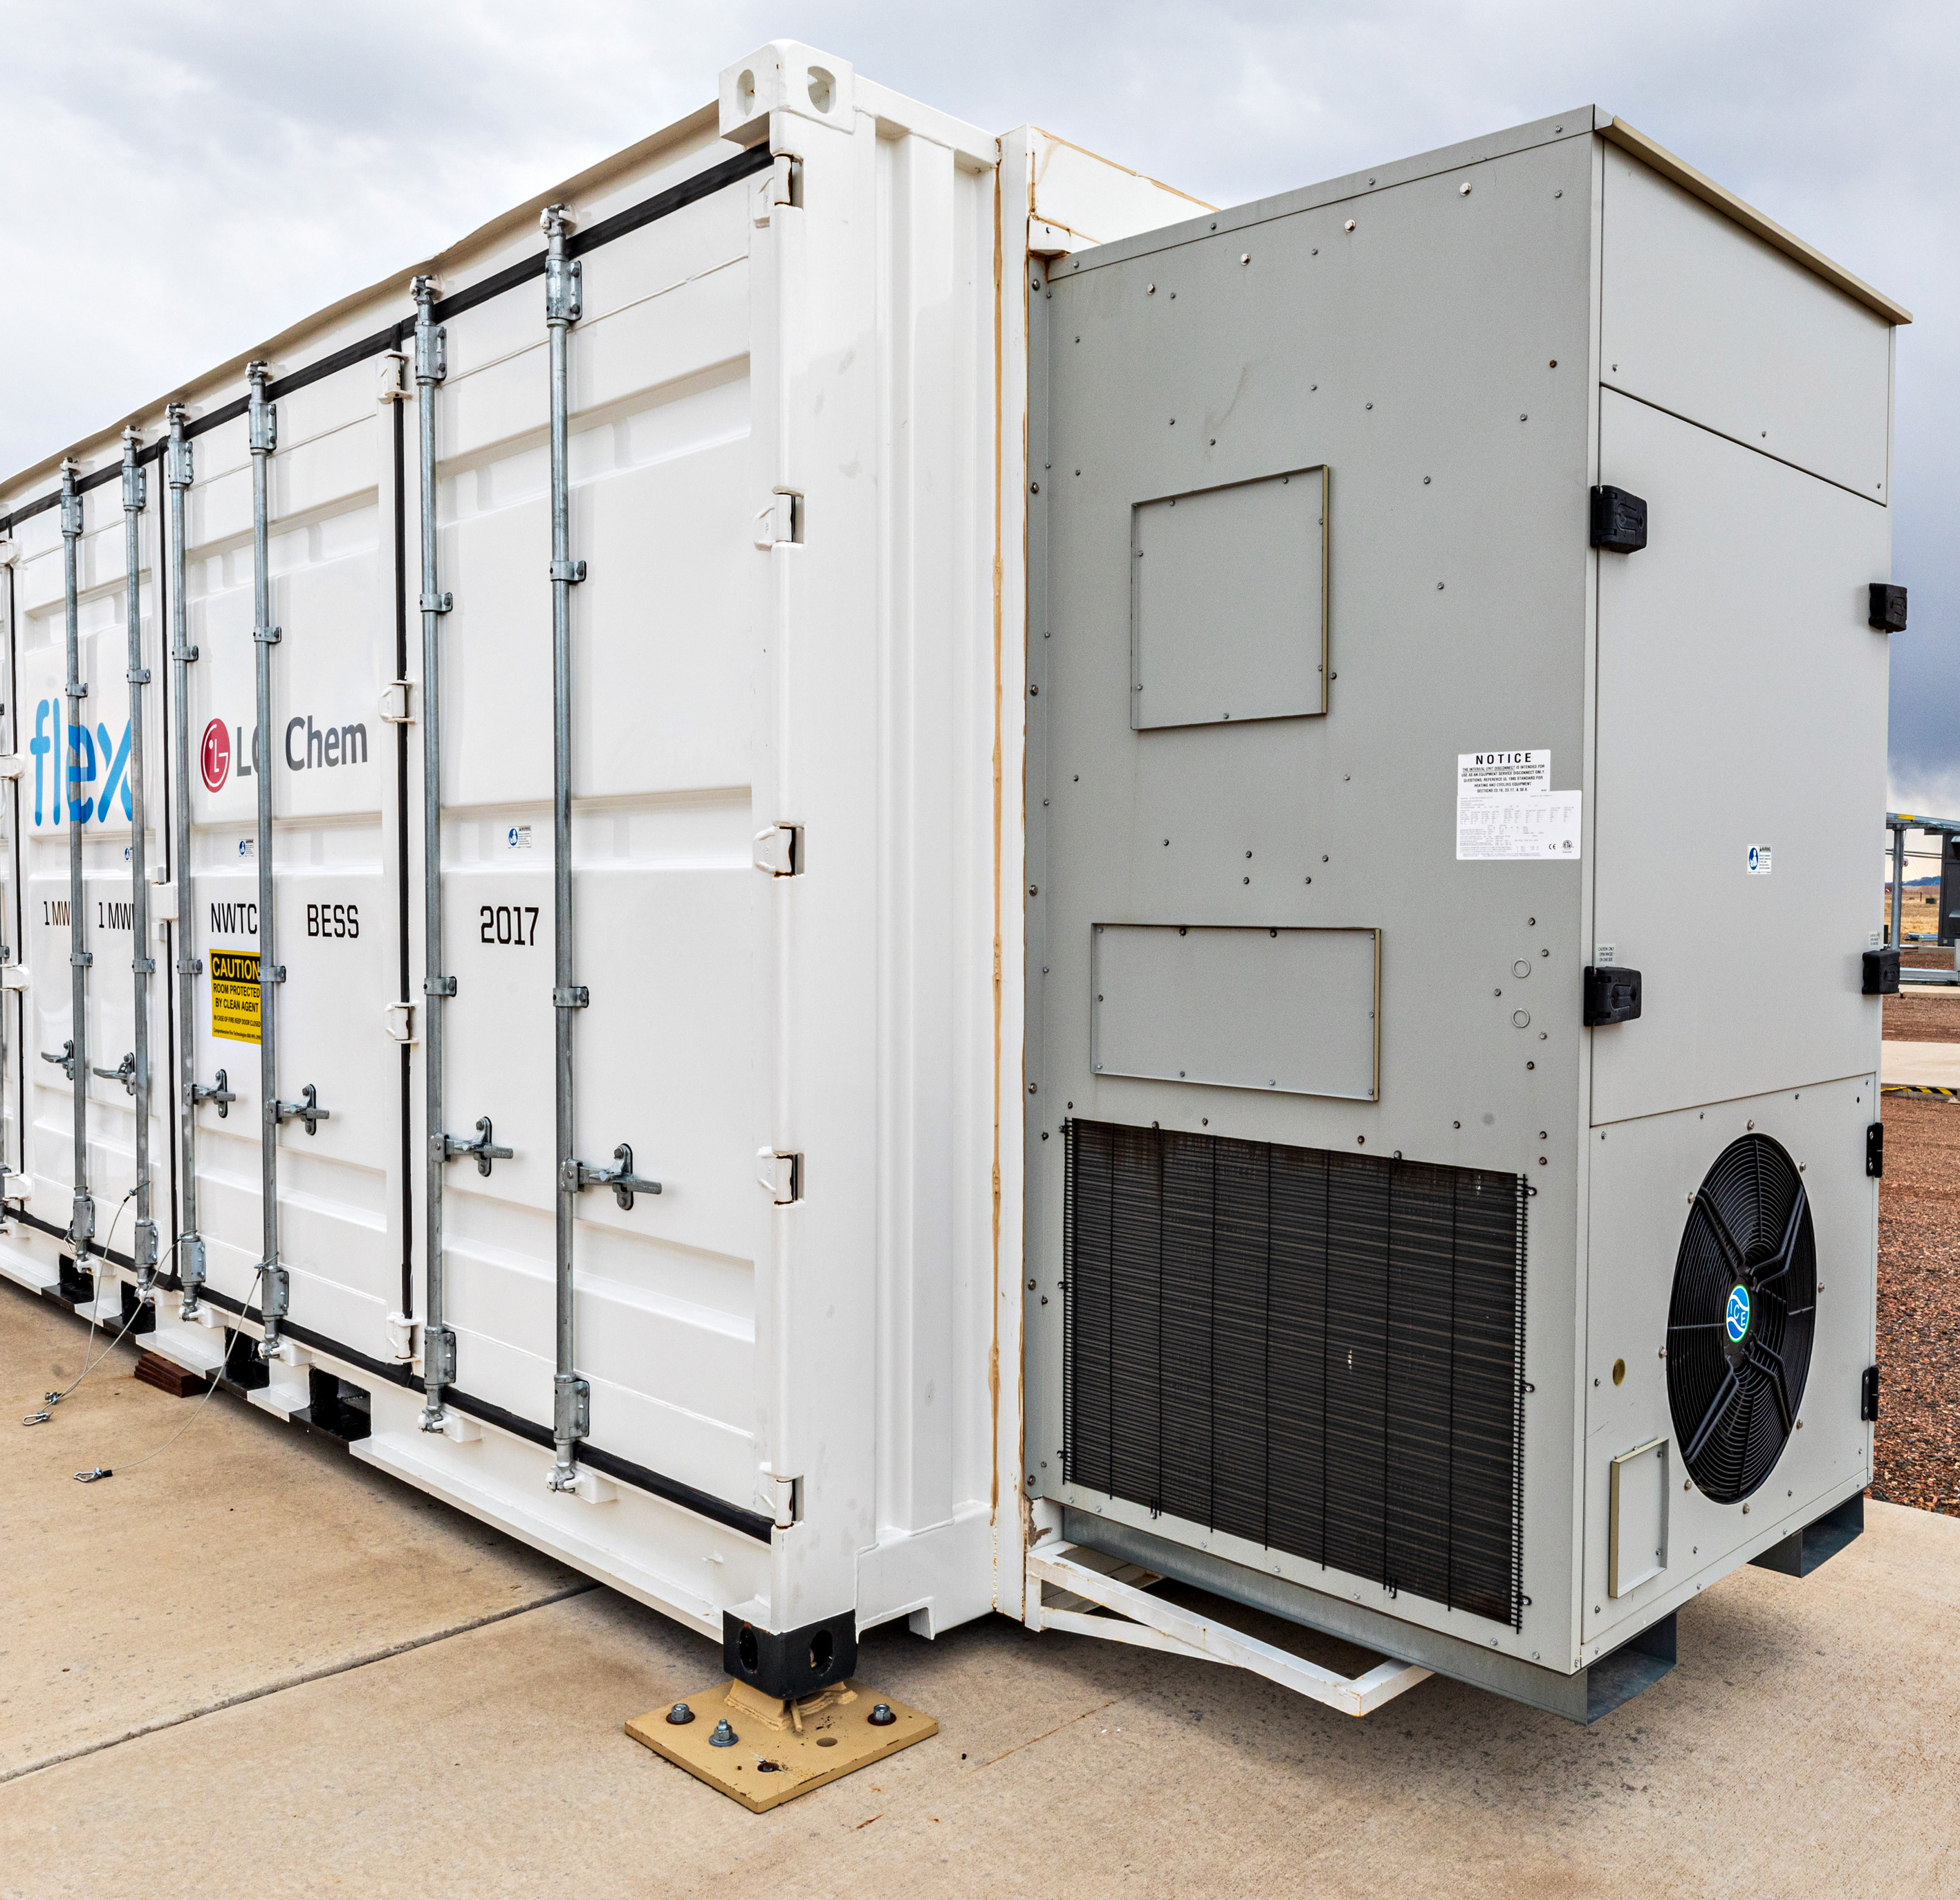
What Are Concerns About Clean Hydrogen for Northern New Mexico?
Land Development
Size and location
What might it look like?
Hours of operation
Traffic, noise, and light
Water Use
Water consumption
Water rights
Water reuse, treatment, and discharge
Environmental, Health, and Safety
Storage and containment
Public health and safety
Climate and environment
Technology readiness and commercial availability
Costs and Alternatives
Equipment and construction cost
Operation and maintenance cost
Ownership and rate payer impacts
Carbon-free electricity and fuel alternatives
Notes:
Chrissy
Facility locations have yet to be determined
Grid-tied application would likely be located on Chevron’s tailing facility (west of Questa). Would require about 105 acres of land, largely for a grid-tied solar pv array, adjacent to the hydrogen facility.
Vehicle fueling application would likely be located at Chevron’s mine facility (east of Questa up RT38). Would require about 30 acres of land, including an off-grid solar pv array, co-located with the hydrogen facility.
These locations will help lessen their impact on the community and environment.

Slide 23
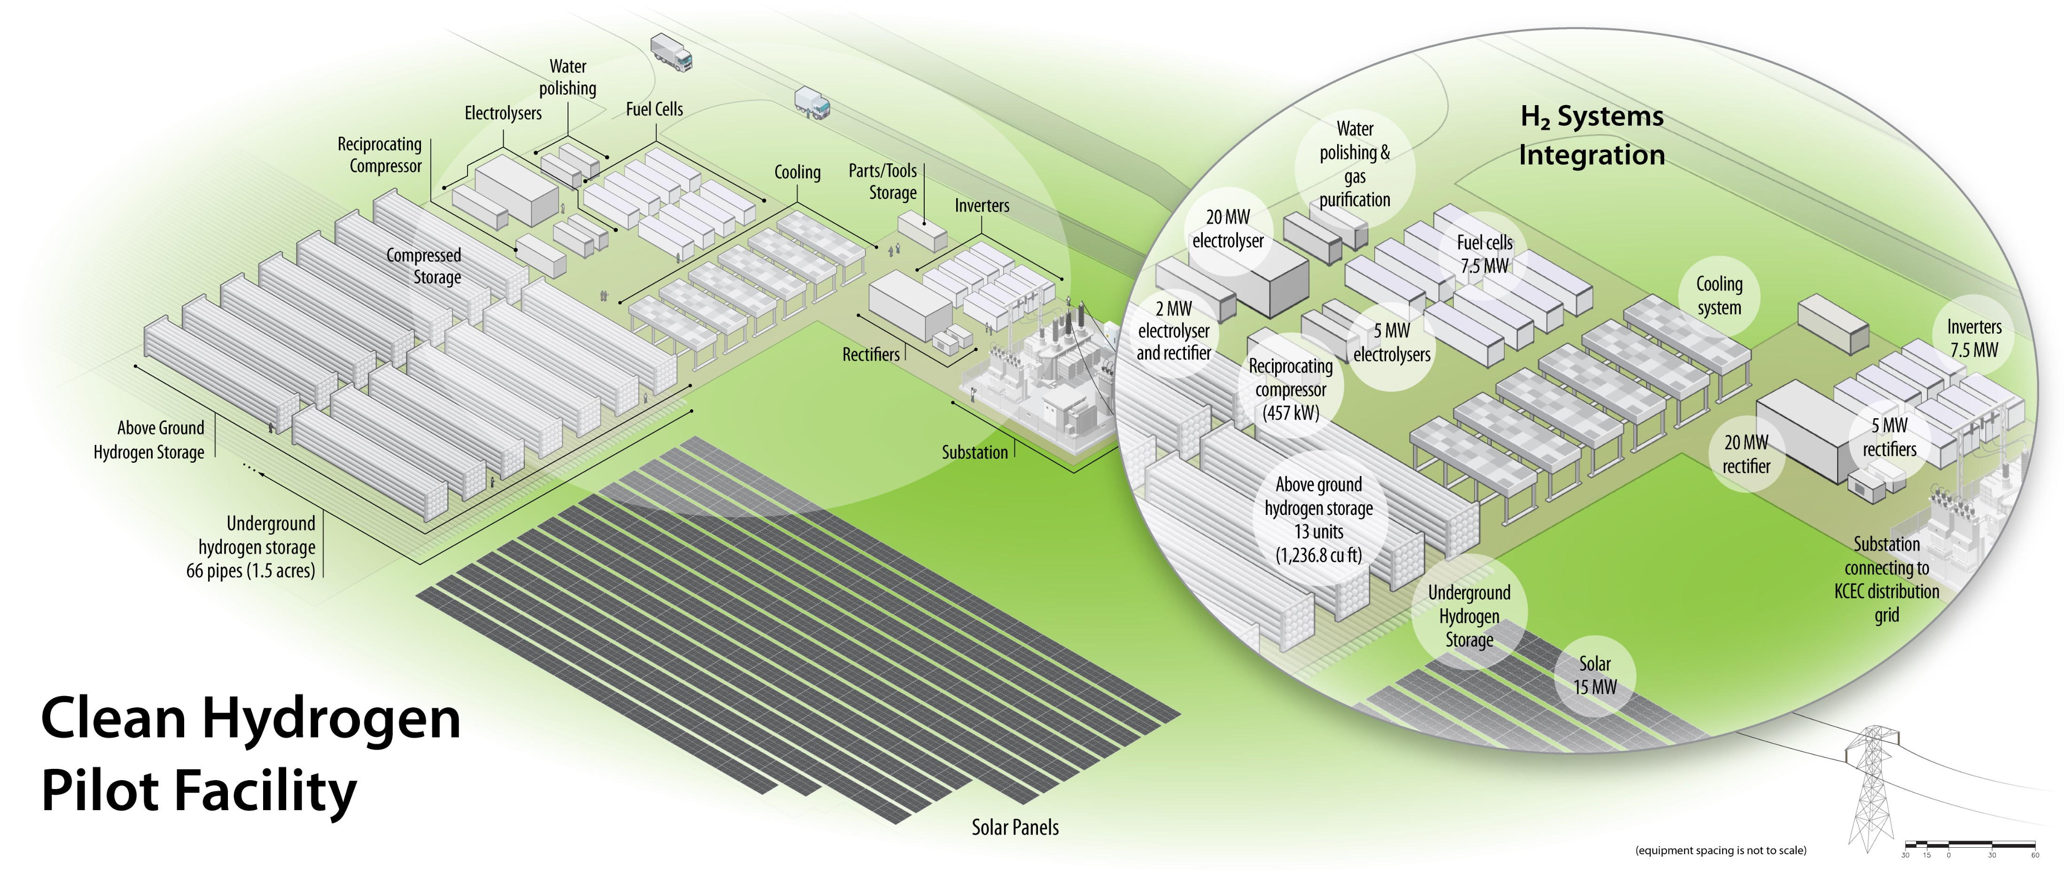
What Might the Questa Grid-Tied Clean Hydrogen Facility Look Like?
Illustration by Al Hicks, NREL
Notes:
Chrissy
Facilities might look like light industrial buildings or a gas station, would operate 24/7, with at least one manned staff.
Would generate traffic, noise, and light.
Some of these impacts can be mitigated through local ordinances, although standards for safety and emergency response must be met.
Here you can see what the grid-tied facility might look like
90-105 acres of land, 103 acres for 15MW solar PV array, 2 for non-pv components
Compressed storage is proposed to be underground, but will be determined by soil conditions of ultimate facility site

Slide 24
What Are Concerns About Clean Hydrogen for Northern New Mexico?
Land Development
Size and location
What might it look like?
Hours of operation
Traffic, noise, and light
Water Use
Water consumption
Water rights
Water reuse, treatment, and discharge
Environmental, Health, and Safety
Storage and containment
Public health and safety
Climate and environment
Technology readiness and commercial availability
Costs and Alternatives
Equipment and construction cost
Operation and maintenance cost
Ownership and rate payer impacts
Carbon-free electricity and fuel alternatives
Notes:
Chrissy
Grid-tied application would consume about 5 acre-feet of water per year, not including water for cooling. About the equivalent of 21 New Mexico households in a year.
For this study, water consumption is an area that needs to be studied further.
If this project were to move forward, the Community Coalition could request water consumption data from potential developers.
What we are currently estimating for this facility is comparable that consumed in natural gas power plants or coal power plants.
Vehicle fueling application would consume about 2 acre-feet of water per year, not including water for cooling. About the equivalent of 7 New Mexico households in a year.
Source of water rights has not been determined. Exploring purchase/transfer/trade of Chevron water rights or other partners. No village rights are being considered.

Slide 25
Where does the water go?
Legend
= 1 gal
= 10 kWh
H₂
= 1 kg of H₂
Electrolyzer
Fuel Cell
Vented oxygen (and water)
3.8 gal
Fuel Cell Exhaust
(air and water vapor)
Electricity
20 kWh
Water
-
+
Air Intake
Hydrogen
55 kWh
H₂
1 kg of Hydrogen
1 kg of Hydrogen
H₂
Electricity
O₂
H₂
0.2 gal
Water
Water Electrolyzer
Fuel cell
Facility A = 5 acre-feet per year (not including water for cooling) = 21 New Mexico homes
Facility B = 2 acre-feet per year (not including water for cooling) = 8.5 New Mexico homes
Notes:
Chrissy
Hydrogen can be produced by splitting water (two hydrogen molecules with one oxygen molecule) into hydrogen and oxygen using electricity.
Water vapor is ventilated and lost to the atmosphere after it passes through the electrolyzer.
When hydrogen is converted to electricity by a fuel cell, water is the primary byproduct. This water can be captured and reused or discharged in a body of water.
Use of treated effluent is feasible
Water captured from fuel cells can be safely reuse or discharged after light treatment to remove impurities from the mechanical equipment it passes through.
Prior to discharge, permits and quality compliance will be required by the NM State Engineer, NM State Environmental Department, and the Environmental Protection Agency
Hydrogen gas itself is not toxic or poisonous, it will not contaminate water sources. . Although it is an indirect greenhouse gas (we will talk about that next),

Slide 26
Pause for Questions
Taos
Notes:
Kayla

Slide 27
What Are Concerns About Clean Hydrogen for Northern New Mexico?
Land Development
Size and location
What might it look like?
Hours of operation
Traffic, noise, and light
Water Use
Water consumption
Water rights
Water reuse, treatment, and discharge
Environmental, Health, and Safety
Public health and safety
Storage and containment
Technology readiness and commercial availability
Climate and environment
Costs and Alternatives
Equipment and construction cost
Operation and maintenance cost
Ownership and rate payer impacts
Carbon-free electricity and fuel alternatives
Notes:
Chrissy
Hydrogen has been used in the US for industrial purposes for over 80 years (for example in cooling power plant generators, oil refining, and ammonia production).
Thus, there are already standards for safe handling and transport of hydrogen, similar to other flammable gases. (such as propane or natural gas),
The use of renewable-generate hydrogen as an energy storage system is a relatively new application in the US.
This project proposes to demonstrate a new approach to energy storage using hydrogen technology that is cleaner than older hydrogen technology and fossil-based electricity generation.
Like other flammable gases hydrogen can be explosive if ignited. Fire and explosion can cause loss of life, injury, and property damage
For this to occur, a buildup of hydrogen gas in a confined area (due to leaking and improper management) would need to be exposed to an ignition source.
Which is why proper ventilation, monitoring and management, as well as emergency shutoffs are important in the design and operation of a facility.
Hydrogen is odorless, tasteless, and invisible during the daylight, making it difficult to detect.
Best practice fire management is to shut off fuel supply. Thermal cameras should be used to detect flames.
Operations management and emergency response personally should receive hydrogen-specific safety training to understand its unique qualities and concerns.

Slide 28
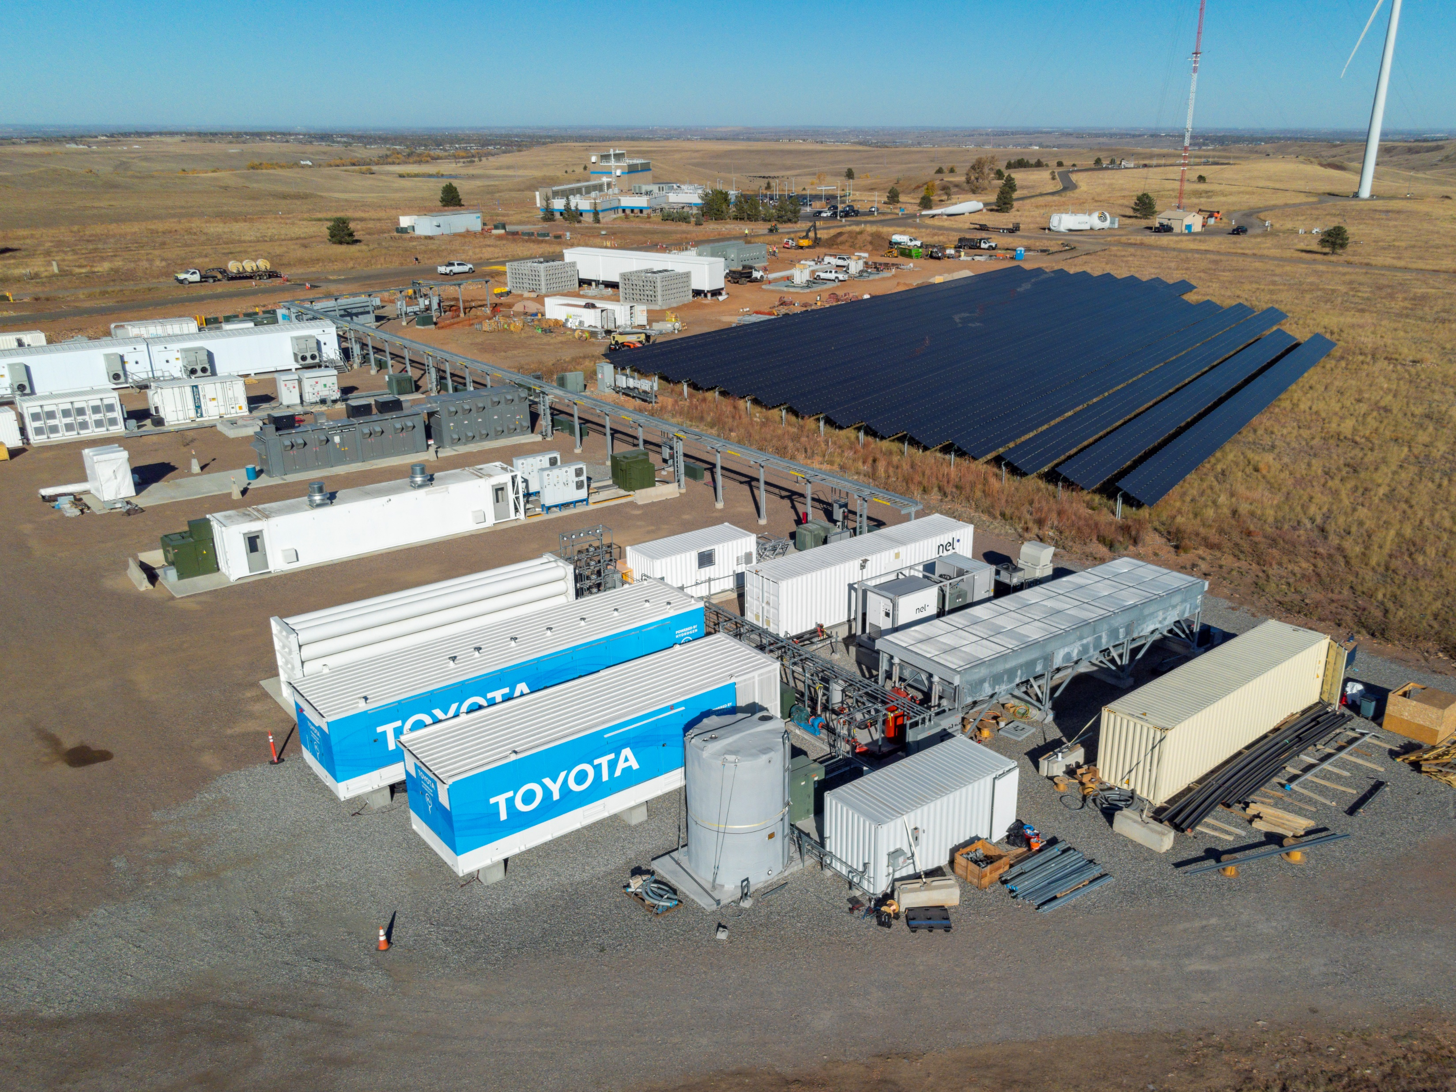
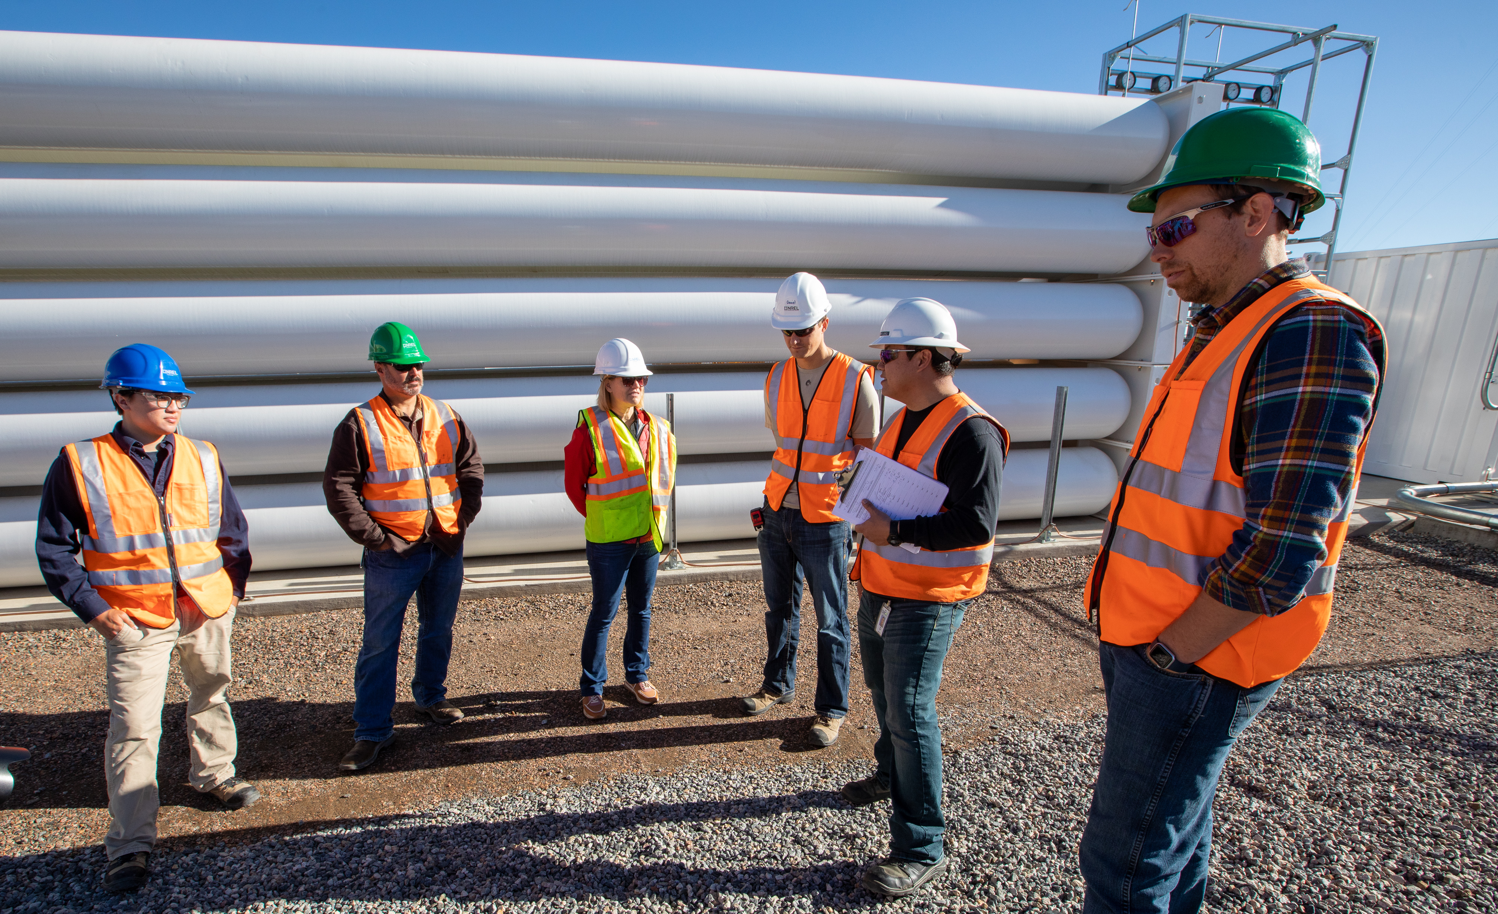
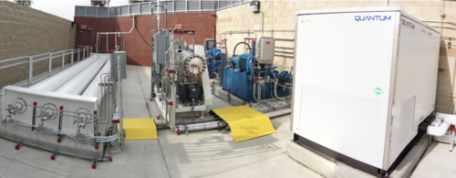
Has this been done before?
Installed hydrogen system at NREL's Flat Irons Campus. Photo by Josh Bauer/Bryan Bechtold, NREL 73051
Example above ground hydrogen storage. Photo by Werner Slocum, NREL 72174
Example above ground hydrogen storage. Photo by California State University
Vehicle refueling. Picture from California State University
Notes:
Chrissy
Hydrogen is stored in pressurized tubes equipped with leak detection and monitoring devices. Tubes can be stored above ground or below ground.
The images above show a grid-tied testing facility at NREL’s campus in Colorado and a fueling facility in California that has been operational for nearly ten years. You can see the stacked storage tubes.
Hydrogen is an indirect greenhouse gas that has stronger warming effects, but is shorter-lived, than other greenhouse gases. If leaked, it causes atmospheric warming.
If hydrogen gas is burned it generates NO_{x} which can cause human respiratory illness and contributes to climate change.
Burning of hydrogen in combustion engines is not anticipated for this project, or transport or distribution of hydrogen gas.

Slide 29
What Are Concerns About Clean Hydrogen for Northern New Mexico?
Land Development
Size and location
What might it look like?
Hours of operation
Traffic, noise, and light
Water Use
Water consumption
Water rights
Water reuse, treatment, and discharge
Environmental, Health, and Safety
Storage and containment
Public health and safety
Climate and environment
Technology readiness and commercial availability
Costs and Alternatives
Equipment and construction cost
Operation and maintenance cost
Ownership and rate payer impacts
Carbon-free electricity and fuel alternatives
Notes:
Chrissy
The coalition has not determined who will own and operate the grid-tied facility. Several aspects of the potential facility need to be explored before such a determination would be made.
Chevron is exploring the possibility of developing the vehicle fueling facility to fuel its earth moving equipment at the mine site in support of its corporate sustainability goals.
Grid-tied
equip + construction cost = $44.5 MM (without incentives)
Levelized cost of electricity = $0.45/kWh (with incentives) – rolls capital, labor for 10 permanent jobs, operations, and maintenance costs (including electricity, water, and land inputs) into one cost over the life of the project. this would be the direct cost to KCEC, not the direct cost to customers. KCEC would recover this cost through rates, similar to how they recover cost for new solar, batteries or transmission projects.
Vehicle fueling
equip + construction cost = $18.9 MM (without incentives)
Levelized cost of hydrogen = $4.77/kg translates to $3.82/gal diesel equiv. (with incentives)
(including 1 permanent job)

Slide 30
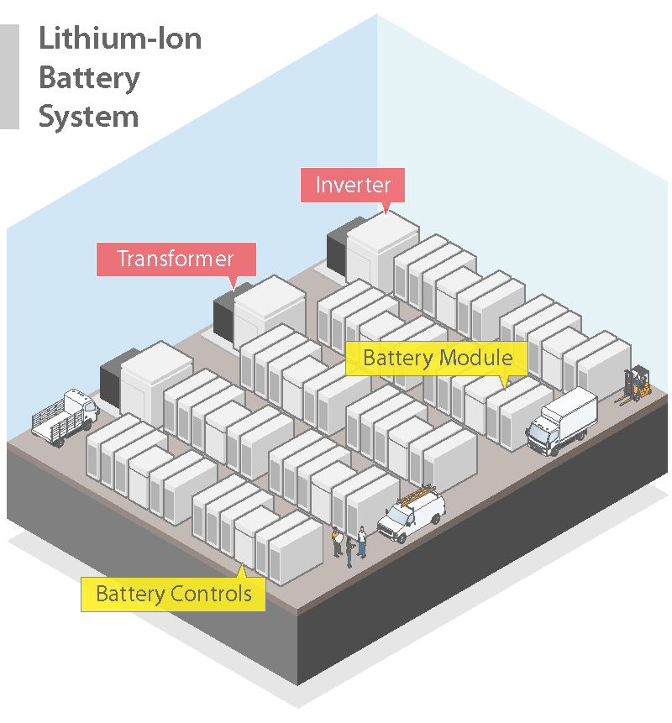
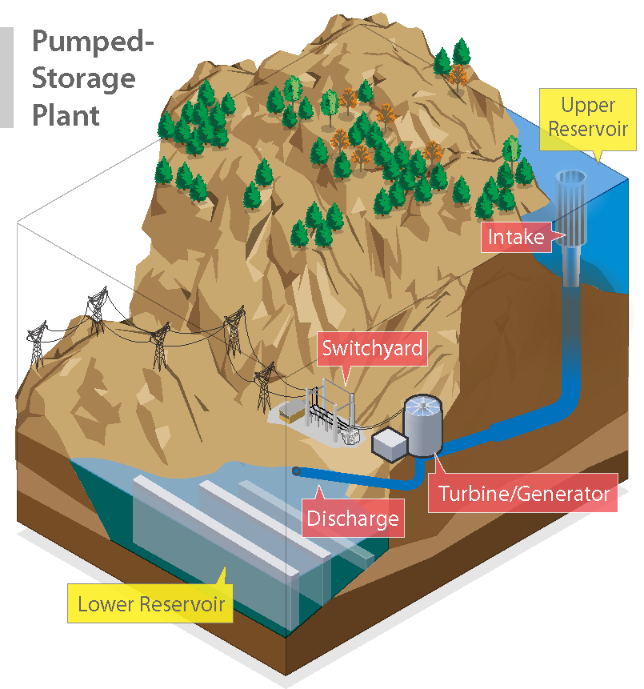
What are alternatives to hydrogen energy storage and fuel?
Illustration by Al Hicks, NREL
Illustration by Al Hicks, NREL
Notes:
Chrissy
Energy decarbonization is required by New Mexico Law (2019 Energy Transition Act requires rural co-ops to transition to carbon-free electricity by 2050 and 50% clean electricity in 2030)
KCEC is deploying multiple existing technologies to meet its 100% renewable generation goal, including solar, batteries, and transmission projects to import wind from east of the Sangres.
It has already achieved 100% daytime renewables but in order to provide clean power during the night time or when solar and wind isn’t available it needs an energy storage solution.
Other long-duration storage alternatives (bio-fuels, natural gas, pumped hydro), rely on fossil fuels/generate emissions or scarce natural resources (such as precious metals and water)
Bottom line – energy storage is necessary and every solution has a tradeoff.

Slide 31
Western Environmental Law Center: Key Principles for Hydrogen Development
Hydrogen could contribute to decarbonization by following key principles and integrating guardrails.
Principle | Strategies
Production | Prioritize electrolytic hydrogen powered by renewables Address environmental and public health risks Utilize additional renewable energy Apply strict water quality and water efficiency standards
Transportation and storage | Co-location of production and use Embed leakage monitoring in pipelines and storage
End uses | Directed to hard-to-electrify applications Should not be used where direct use of renewable electricity offers a better alternative Should not be used to generate baseload power
Community involvement and risk mitigation | Community members and stakeholders engaged throughout entire process Opportunity to give meaningful feedback Potential harms identified and mitigated
(Matrix derived from letter sent to WISHH leaders by WELC in collaboration with over 24 other New Mexico organizations.)
Notes:
Chrissy
Acknowledge WELC and principles - Matrix derived from letter sent to WISHH leaders by WELC in collaboration with over 24 other New Mexico organizations
“Hydrogen could play a role in decarbonization by following key principles and integrating strong guardrails against adverse climate and environmental consequences”...
This is another set of tools and principles the community coalition can use to assess if clean hydrogen is a good fit for Questa.
Next we will discuss how you can stay involved in the process.

Slide 32
Pause for Questions
Taos
Notes:
Kayla

Slide 33
Potential Next Steps for Building a Hydrogen Production Facility
Financial
Analysis
Water
Rights
Design and
Engineering
Construction
Begins
Plant
Online
RFP
Technical Assistance Phase
Implementation Phase
Public Engagement
Potential Partners
And Regulators
Key
Stakeholders
Special Interests Groups
General Public
KCEC Trustee Vote/Village Council Resolution
Ownership
Memorandum of Understanding
Financing
Permitting
Job Training
Notes:
Chrissy
Any potential hydrogen project(s) undertaken by coalition members would involve several steps. (for example…)
This includes a deeper assessment of financial models and board approvals to proceed with partnership development and project financing.
Public engagement could be ongoing through the permitting process.
Community members and the Coalition could negotiate with developers for community benefits (such a local hiring and job training) early in the partnership formation and permitting processes
Shortly we will share a list of projects contacts so you can stay involved

Slide 34
Pause for Questions
Taos
Notes:
Kayla

Slide 35
Contact: Questa Community Coalition and Technical Assistance Team
Community Coalition |  |  | Technical Assistance (TA) Providers
Name | Title | Email | Name | Role | Email
John Ortega | Mayor, Village of Questa | jortega@villageofquesta.org | Elaine Hale | Community Lead (NREL) | elaine.hale@nrel.gov
Jake Lafore | Project Manager, Village of Questa | jlafore@villageofquesta.org | Chrissy Scarpitti | Community Lead (NREL) | chrissy.scarpitti@nrel.gov
Chris DeFillippo | Village Attorney, Robles, Rael & Anaya | chris@roblesrael.com | Kevin Topolski | Hydrogen Infrastructure Analyst (NREL) | kevin.topolski@nrel.gov
Luis Reyes | CEO and General Manager, KCEC | lreyes@kitcarson.com | Haider Niaz | Hydrogen Infrastructure Analyst (NREL) | haider.niaz@nrel.gov
Richard Martinez | Chief Operating Officer, KCEC | rmartinez@kitcarson.com | Andre Fernandes | Economist (NREL) | andre.fernandestomonavelino@nrel.gov
Lynn Skall | Director, Questa Economic Development Fund | lynn@questaedf.com | Alberto Franco | Economist (NREL) | alberto.franco@nrel.gov
Gabriel Herrera | Public Affairs Advisor, Chevron | Gabriel.Herrera@chevron.com | Patricia Sullivan | Associate Dean, Outreach and Recruitment, College of Engineering (NMSU) | patsulli@nmsu.edu
Christian Isely | State Government Affairs Representative, Chevron | cisely@chevron.com | Kayla Copeland | Outreach Facilitator (Sundance) | kcopeland@sundance-inc.net
Mark Urfer | Site Manager, Chevron | Mark.Urfer@chevron.com | Riley Wittler | Outreach Facilitator (Sundance) | rwittler@sundance-inc.net
 |  |  | Duncan Mcbranch | New Mexico strategy development for WISHH (LANL) | mcbranch@lanl.gov
KCEC: Kit Carson Electric Cooperative
LANL: Los Alamos National Laboratory
NMSU: New Mexico State University
NREL: National Renewable Energy Laboratory
WISHH: Western Interstate Hydrogen Hub
Notes:
Kayla

Slide 36
Thank you
https://www.energy.gov/communitiesLEAP/questa-new-mexico
Notes:
Kayla

Slide 37
Additional Information
Publication Number: DOE/GO-102023-6016

Slide 38
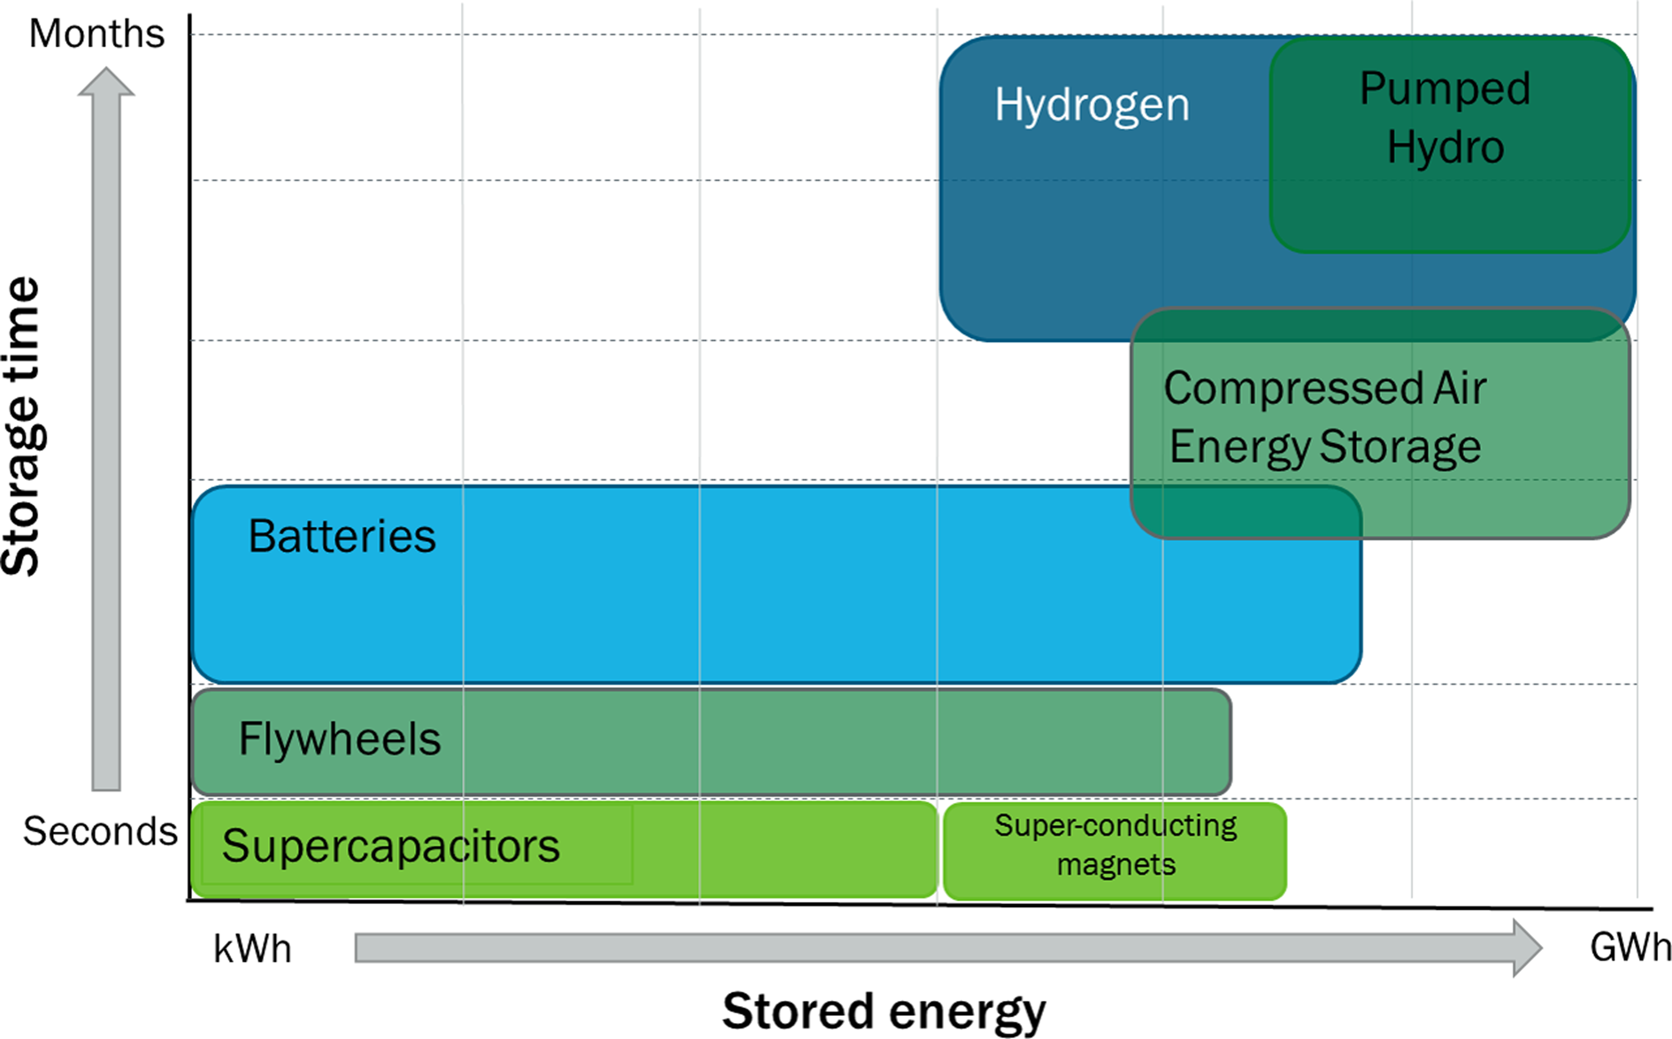
For Some End Uses, H₂ Storage Could Be More Cost-Effective Than Batteries
This project examines two end uses that are challenging to decarbonize:
Electricity demand when there is little sunshine and wind
Off-road vehicle transportation.
Batteries can partially meet these end uses with high energy efficiency but at limited scale (timescale of hours).
Like batteries, hydrogen is a carbon-free energy carrier, but unlike batteries, it can be stored at scale (days to months timescale). This scaling is key for:
Electricity demand during prolonged periods of low wind and sun resource
Heavy-duty vehicles.
Integrating batteries and hydrogen systems with clean energy generation can provide short- and long-duration storage across multiple scales of energy needs.
H₂ as long-term energy storage²
Figure 2. Hydrogen versus other energy storage options in context of amount of stored energy and storage duration [5]

Slide 39
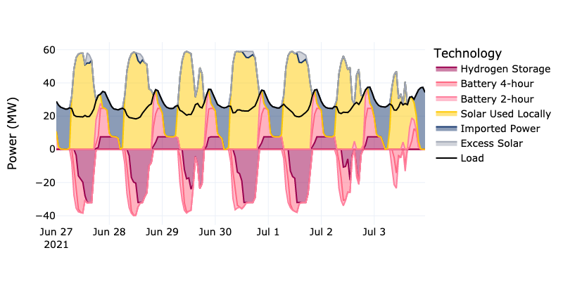
Modeled KCEC Dispatch Approach Maximizes Local Use** of Solar
Load and Generation
*
Hydrogen storage is last in the local dispatch stack after solar and batteries.
Actual operations would factor in dynamic properties of markets for imported and exported power.
Storage Charging
*Excess solar is solar generation beyond what is used to directly meet load, charge batteries, and generate hydrogen.
**“Local use” implies use within KCEC service territory.

Slide 40
Hydrogen Storage Is Sized To Buffer Supply/ Demand Imbalances for Fueling
hydrogen demand exceeds supply
hydrogen supply exceeds demand
hydrogen demand exceeds supply
Hydrogen storage is used to resolve daily and seasonal supply and demand mismatches for vehicle refueling.
Refined sizing would factor in year-to-year weather variation and fuel demand uncertainties.

Slide 41
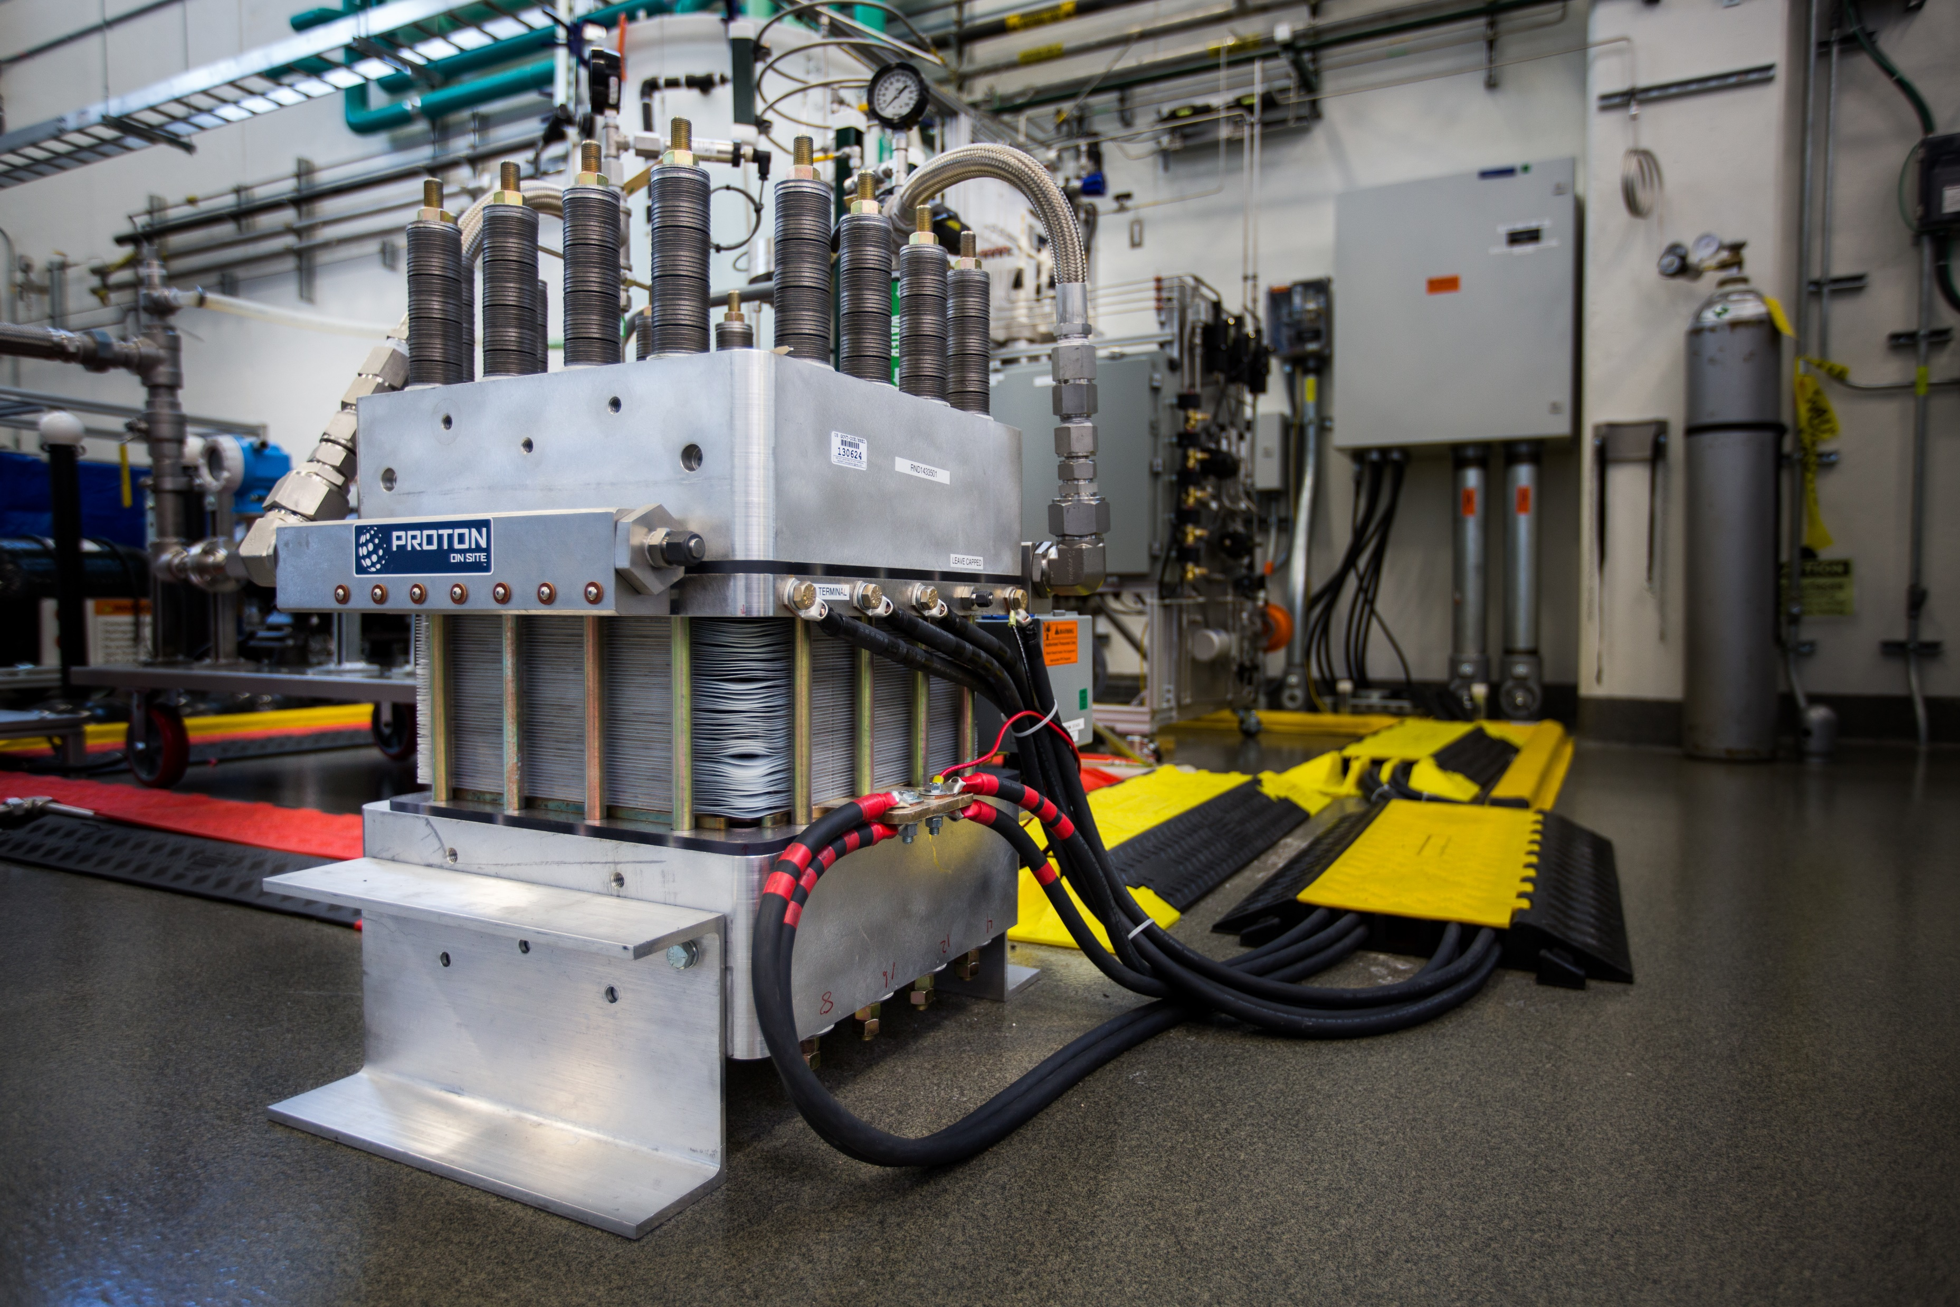
What Are the Land Development Impact Concerns?
What might it look like?
Utility-scale solar generation facilities require substantial land but are generally low profile.
PEM hydrogen production facilities look much like light industrial buildings.
Hydrogen fueling stations look much like gasoline stations.
How much land would be required?
6-7 acres per 1 MW of solar PV power generation capacity.
Overall facility would require 90–105 acres of land
Approx. 103 acres for 15 MW of on-site solar PV
Approx. 2 acres for all non-PV components (electrolyzer, fuel cell, and belowground hydrogen storage (in compressed tubes)).
Aboveground compressed storage may be required
Tubes are typically stacked in rows approximately the size of a 40’x10’tall shipping container.
Approx. 28 stacks of tubes of compressed storage would be needed
What hours will it operate, and will there be traffic, noise, or light impacts?
Facilities operate 24 hours per day, 7 days per week with at least one staff person.
May generate noise, nighttime light, glare, and traffic.
Traffic would be generated in an alternative fuel application.
Earth-moving equipment and long-haul trucks are likely consumers.
Location of the fueling facility TBD but would be near the mine site.
Example electrolyzer. Photo by John De La Rosa, NREL 34729
Example above ground hydrogen storage. Photo by Werner Slocum, NREL 72174
Notes:
What might it look like?
Utility-scale solar generation facilities require substantial land but are generally low profile.
PEM hydrogen production facilities look much like light industrial buildings.
Hydrogen fueling stations look much like gasoline stations.
How much land would be required?
KCEC approximates 6-7 acres per 1 MW of solar PV power generation capacity.
The overall facility size estimate is 90–105 acres of land for 15 MW of on-site solar PV, electrolyzer, fuel cell, and belowground hydrogen storage (in compressed tubes). At most, 2 acres would be required for all non-PV components.
Aboveground compressed storage tubes are typically stacked in rows approximately the size of a 40’x10’tall shipping container. For estimation purposes, this project could require approx. 28 stacks of tubes of compressed storage (or 14 stacks of 80’ tubes, as illustrated in future slides).
What hours will it operate, and will there be traffic, noise, or light impacts?
Hydrogen facilities often operate 24 hours per day, 7 days per week with at least one staff person present. This may generate noise, nighttime light, glare, and traffic.
Traffic would be generated in an alternative fuel application. Earth-moving equipment and long-haul trucks are the most likely consumers of hydrogen fuel. The location of the fueling facility is yet to be determined but would be near the mine site.

Slide 42
How Can Land Development Impact Be Mitigated?
Underground storage tanks proposed to reduce visual impact, pending site constraints.
Aboveground storage would be stacked in high-pressure pipes.
Solar PV arrays and hydrogen production facility potentially located on Chevron’s Tailing Facility site (west of Questa).
put a brownfield site to beneficial use, limit the disturbance of natural lands
reduce visual impact by locating the array at a lower elevation, vegetation and fencing can further screen
Refueling station potentially co-located on Chevron’s mine remediation site (east of Questa), limit refueling traffic.
Permitting jurisdiction could negotiate impact mitigation terms as a condition for permit approval (community benefits plan).
The village could adopt ordinances (hours of operation, traffic, noise, and lighting) but must meet safety standards.
Transmission and distribution infrastructure is largely already in place, may require new substation and short transmission line.
Notes:
Storage tanks are proposed to be underground to reduce visual impact, but this could be a constraint of the site where the facility would be located. Aboveground storage would be stacked in high-pressure pipes.
The solar PV arrays and hydrogen production facility could potentially be located on Chevron’s Tailing Facility site west of Questa. This would put a brownfield site to beneficial use, limit the disturbance of natural lands, and reduce visual impact by essentially “hiding” the array at a lower elevation. Visual impacts of PV arrays can further be mitigated through vegetation and fencing.
A refueling station could be co-located on Chevron’s mine remediation site, limiting the impact of traffic for refueling.
The jurisdiction could require the developer to meet performance standards as a condition for permit approval. Other development agreements, such as local hiring commitments, training programs, local materials sourcing, economic/environmental remediation funds, special tax assessments, or other community benefits agreements could similarly be negotiated during the development review [24].
The village could adopt an ordinance to regulate hours of operation, traffic, noise, and lighting to protect night skies, animal migration, and quality of life for residents.
Transmission and distribution infrastructure is largely already in place or would utilize existing corridors (including tailing facility). A new substation and short transmission line for interconnection may be required.

Slide 43
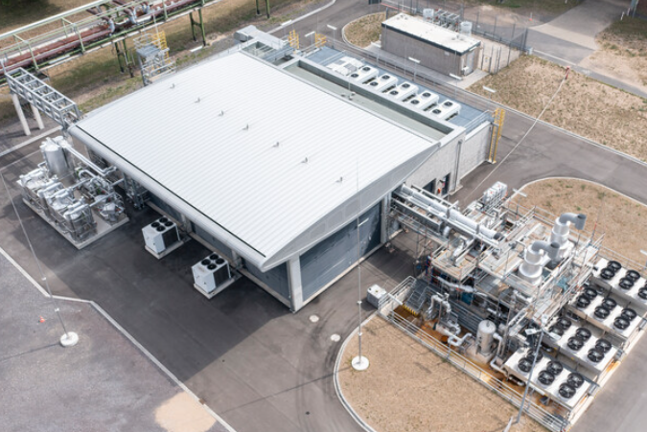
Example Project: Shell’s Rhineland Refinery
10-MW PEM electrolyzer located in Wessling, Germany
Europe’s largest PEM and the first to apply it at such a large scale in a fuel refinery
Operated by Shell, beginning July 2, 2021
Uses renewable electricity to produce up to 1,300,000 kgs of green hydrogen a year
PEM electrolyzers, which are more compact than conventional alkaline electrolyzers, can operate dynamically with varying load, making them well-suited for renewable energy.
(Questa’s proposed facility would utilize a 32-MW electrolyzer.)
Birds eye view of Shell’s PEM green hydrogen production facility. Image by Shell Photographic Services.

Slide 44
What Are the Water Use Concerns?
How much water will be needed?
3.78 gallons of water = 1 kg of hydrogen, approx. 5% is “recovered” from the fuel cell exhaust without a dedicated cooling system.
Approx. 5.34 acre-feet of water per year needed for grid-connected storage application, 0.27 acre-feet returned (about 0.18 gallon of water per kWh of power).
Approx. 1.82 acre-feet of water per year needed for vehicle fueling application. None returned.
Where will it come from and how much will it cost?
Source of water rights has not been determined. Exploring purchase/transfer/trade of Chevron water rights or other partners.
What quality is needed for electrolysis, and can non-freshwater be used?
Water quality needed for electrolysis is ASTM Type II. Any water could be used as input. Non-potable water would require more treatment and increase costs.
Can water used for hydrogen production be reused? Where will it be discharged, and how will it be treated before it is discharged?
When hydrogen is converted to electricity by fuel cell, water is the primary byproduct. This water can be captured and reused or discharged in a body of water.
Treatment may be required prior to discharge for removal of aluminum, nickel, nitrite, and manganese which could exceed U.S. Environmental Protection Agency (EPA) drinking water limits.
Nitrates - essential plant nutrients, but can cause water quality issues and be toxic to animals when concentrated (wastewater).
Hydrogen gas is not toxic or poisonous. It will not contaminate water sources.
Permits and quality standard compliance will be required by the NM State Engineer, NM State Environmental Department, and the EPA.
Notes:
How much water will be needed?
It takes 3.78 gallons of water to generate 1 kg of hydrogen [2]. After hydrogen is converted to electricity using a fuel cell, 5% of this water is estimated to be “recovered” from the fuel cell exhaust [4] without a dedicated cooling system.
We estimate that the grid-connected storage application would withdraw 5.34 acre-feet of water per year and return 0.27 acre-feet, which works out to about 0.18 gallon of water per kWh of power put back on the grid.
Where will it come from and how much will it cost?
The source of the water rights has not been determined but will impact project economics. Potential sources of water rights being explored include purchase/transfer/trade of Chevron water rights or other partners.
What quality is needed for electrolysis, and can non-freshwater be used?
Water quality needed for electrolysis is ASTM Type II [10]. Any water could be used as input, but non-potable water would require more treatment and increase costs.
Can water used for hydrogen production be reused? Where will it be discharged, and how will it be treated before it is discharged?
When hydrogen is converted to electricity by fuel cell, water is the primary byproduct. This water can be captured and reused or discharged in a body of water. However, treatment may be required prior to discharge into water bodies because it contains impurities such as aluminum, nickel, nitrite, and manganese above U.S. Environmental Protection Agency (EPA) drinking water limits [4]. Nitrates are essential plant nutrients, but can be toxic to warm-blooded animals. They are common in effluent of wastewater treatment facilities and can cause significant water quality problems when accumulated in high concentrations [20].
Hydrogen gas is not toxic or poisonous. It will not contaminate water sources [12].
Permits and quality standard compliance will be required by the NM State Engineer, NM State Environmental Department, and the EPA.

Slide 45
How Can Water Impacts Be Mitigated?
How much water will be needed?
Considered water-recovery and treatment equipment. Current water-recovery equipment is not cost-effective or water-efficient (not included in project cost). Further study needed to bring water to market.
Water consumption without recovery is comparable to natural gas power plants and less than coal power plants.
The best available information was used to estimate water consumption, more research required to increase accuracy of estimated water use.
Where will it come from, and how much will it cost?
The coalition is exploring potential sources of water/water rights. Chevron rights are being considered. No village rights are being considered.
Can water used for hydrogen production be reused? Where will it be discharged, and how will it be treated before it is discharged?
Project will need to meet state and EPA standards for water quality.
Water treatment and discharge are being considered in feasibility, but costs are expected to be low.
System should be designed to allow for monitoring of water quality and prevent and mitigate accidental water discharge.
Notes:
How much water will be needed?
This project considered water recovery and treatment equipment. Current findings show that water-recovery equipment is not cost-effective or water-efficient. Thus, water capture is not included in grid-connected energy storage project cost. Further study is needed to bring cost-effective water recovery to market.
Water consumption for this facility without recovery is comparable to natural gas power plants and less than coal power plants, both equipped with recirculating cooling systems [21, 22].
The best available information was used to estimate water consumption for this project, but more research is required to increase accuracy of estimated water use of all system components.
Where will it come from, and how much will it cost?
The coalition is exploring potential sources of water/water rights. Chevron rights are being considered. No village rights are being considered.
What quality is needed for electrolysis, and can non-freshwater be used?
Non-potable water sources are being considered by the Village of Questa.
Can water used for hydrogen production be reused? Where will it be discharged, and how will it be treated before it is discharged?
Project will need to meet state and EPA standards for water quality. System should be designed to allow for monitoring of water quality.
Water treatment and discharge are being considered in feasibility, but costs are expected to be low.
Considerations should be made to prevent and mitigate accidental water discharge.

Slide 46
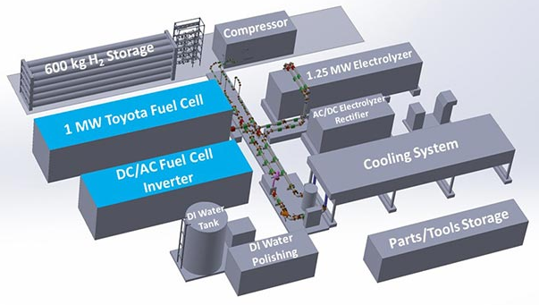
Example Project: NREL Test Facility
Located in Boulder County, Colorado.
Independent research facility testing performance in grid-interconnected system.
Future test facility studies may assess water efficiency and recapture.
Site design and permitting process included setback distances and fire code requirements, high-level electrical system design, process hazard analysis safety evaluation of storage system, compressor, and gas management panel.
Commissioning planned June 2023.
1.25-MW PEM electrolyzer, 1-MW fuel cell, 600-kg H₂ storage equivalent to 20 MWh of storage.
Conceptual hydrogen system design. Illustration by Alfred Hicks, NREL
Installed hydrogen system at NREL's Flat Irons Campus. Photo by Josh Bauer/Bryan Bechtold, NREL 73051

Slide 47
What Are Environmental, Health, and Safety Concerns?
How is hydrogen stored and what if it leaks?
Hydrogen is stored in pressurized tubes equipped with leak detection monitoring devices [9]. Hydrogen transport is not anticipated for this project, but industrial supply chains are established, and protocols follow similar procedures to other flammable gases such as natural gas or propane [10].
Estimated leakage rates for hydrogen in steel pipe is between 0.0004%/day and 0.19%/day [11].
Small leaks are common because hydrogen is a small molecule. Such leaks do not cause a flammable mixture in air because hydrogen is light and tends to dissipate quickly [9]. In order to cause a fire, concentrated hydrogen would need to be exposed to an ignition source, similar to gasoline, natural gas, or propane.
What are the potential public health and safety impacts?
If confined in high enough concentrations, hydrogen can be explosive if ignited [9, 12a, 12b]. Fire and explosion can cause loss of life, injury, and property damage.
Because it dissipates quickly, risk of a flammable mixture or asphyxiation is greatest in confined areas [9]. Note that it is impractical to disperse hydrogen quickly enough in the event of a massive release in an enclosed building [10].
Hydrogen flames are nearly invisible to the human eye in daytime and generate less radiant heat than other fuels such as propane [10, 12b]. Hydrogen, itself, is odorless, colorless, and tasteless [12c], making them difficult to detect.
Workers exposed to high concentrations of hydrogen, similar to other gases, can suffer from asphyxiation (lack of oxygen). Otherwise, hydrogen gas is not toxic [9, 12c].
Electrolyzers and pressurized storage systems present hazards to facility workers due to risk of shock, chemical exposure, or rupture if systems are not properly designed and maintained [13].
When burned, hydrogen generates NO_{x} [7], which can cause human respiratory illness and contributes to climate change [14]. NO_{x} forms when fuels are burned at high temperatures and are primarily generated from motor vehicles and other fuel combustion applications. NO_{x} reacts with other chemicals in the atmosphere to form particulate matter and ground-level ozone, which are also harmful to humans and the planet [14] [15].

Slide 48
What Are Environmental, Health, and Safety Concerns?
How is hydrogen stored and what if it leaks?
Hydrogen is stored in pressurized tubes equipped with leak detection monitoring devices. Hydrogen transport is not anticipated for this project, but industrial supply chains are established, and protocols follow similar procedures to other flammable gases such as natural gas or propane.
Estimated leakage rates for hydrogen in steel pipe is between 0.0004%/day and 0.19%/day.
Small leaks are common because hydrogen is a small molecule. Such leaks do not cause a flammable mixture in air because hydrogen is light and tends to dissipate quickly. In order to cause a fire, concentrated hydrogen would need to be exposed to an ignition source, similar to gasoline, natural gas, or propane.
What are the potential public health and safety impacts?
If confined in high enough concentrations, hydrogen can be explosive if ignited. Fire and explosion can cause loss of life, injury, and property damage.
Because it dissipates quickly, risk of a flammable mixture or asphyxiation is greatest in confined areas. Note that it is impractical to disperse hydrogen quickly enough in the event of a massive release in an enclosed building.
Hydrogen flames are nearly invisible to the human eye in daytime, making them difficult to detect. Hydrogen flames generate less radiant heat than other fuels such as propane.
Workers exposed to high concentrations of hydrogen, similar to other gases, can suffer from asphyxiation (lack of oxygen). Otherwise, hydrogen gas is not toxic.
Electrolyzers and pressurized storage systems present hazards to facility workers due to risk of shock, chemical exposure, or rupture if systems are not properly designed and maintained.
When burned, hydrogen generates NO_{x}, which can cause human respiratory illness and contributes to climate change. NO_{x} forms when fuels are burned at high temperatures and are primarily generated from motor vehicles and other fuel combustion applications. NO_{x} reacts with other chemicals in the atmosphere to form particulate matter and ground-level ozone, which are also harmful to humans and the planet .

Slide 49
What Are Environmental, Health, and Safety Concerns?
What are the potential climate and environmental impacts?
Hydrogen is an indirect greenhouse gas that has stronger warming effects, but is shorter-lived, than other greenhouse gases. If leaked, it causes atmospheric warming [16]. If burned, hydrogen generates NOx, which contributes to climate change.
Has this been done before? Is this technology sound and commercially available?
Hydrogen has been used in industrial applications for over 80 years and can be used as safely as gasoline, natural gas, or propane. Industrial supply systems are well established.
Pure hydrogen is currently used at scale in oil refining and ammonia production. Thus, there are already standards for safe handling and transport of hydrogen. Electrolyzers and fuel cells are newer technologies based on PEMs. These technologies are currently scaling up, but in their fundamentals are cleaner than legacy hydrogen production and combustion processes. We will provide a few examples of existing systems using electrolyzers and fuel cells in the upcoming slides.

Slide 50
How Can Environmental, Health, and Safety Impacts Be Mitigated?
How is hydrogen stored and what if it leaks?
Use design best practices: Production, storage, transport, and dispensing equipment should be sited and built to national standards (International Fire Code and NFPA 2 Hydrogen Technologies Code)--use of non-corrosive and non-flammable materials; properly ventilated; equipped with seals, backflow pretension, impact sensors, leak detection, thermal and optical flame detection, isolation valves, emergency/automatic shut off, and audible and visual alarm systems.
Ensure active ventilation at all times for enclosed buildings to prevent accumulation of flammable mixture.
Decrease risk of ignition in event of hydrogen buildup through design and maintenance of systems.
Manage risks: Like all flammable gases, safety relies on assessing and managing hazards, monitoring systems to ensure integrity, maintaining proper ventilation, managing discharges, detecting and isolating leaks, and having trained personnel.
Water can be used to fight hydrogen fires.
What are the potential public health and safety impacts?
Regularly train emergency management, response, and facilities staff in hydrogen-specific safety. Maintain an active emergency response plan, practice drills and review protocols, and conduct public outreach to ensure staff and community are aware of risks and response procedures. See list of training resources.
NO_{x} is generated primarily from the burning of fuel at high temperatures. The vehicle application in this study assumes use of fuel cells to convert hydrogen to electricity, which does not generate NOx, CO2, or particulate matter. The vehicle application could generate NO_{x} and particulate matter if hydrogen is combusted with combustion engines rather than fuel cells.
What are the potential climate and environmental impacts?
Ensuring that systems are built and maintained to have low leakage rates reduces climate, as well as safety and economic, impacts.

Slide 51
Example Project: Cal State Green H₂ Production and Fueling
Operational since 2014
Located 6 miles from downtown Los Angeles, near freeway
Considered first in the world to sell hydrogen fuel by the kilogram directly to retail customers
Capable of producing and storing 60 kg of hydrogen on-site from renewable energy sources, per day
Construction began in late 2010 as a design-build process; opened on May 7, 2014
Equipped with leak sensors, flame detectors, and other safety devices
Utilizes a Hydrogenics electrolyzer, first- and second-stage compressors enabling 350- and 700-bar fueling, 60 kg of hydrogen storage, water purification and equipment cooling system, grid-tied.
Contact: Dr. David Blekhman. blekhman@calstatela.edu
Technical Director, Hydrogen Research and Fueling Facility
California State University, Los Angeles
Aerial view of fueling station. Picture from Google Streetview
Vehicle refueling. Picture from Cal State https://www.calstatela.edu/ecst/h2station
Construction drawing. Image from Cal State https://www.calstatela.edu/ecst/h2station/history

Slide 52
What Are the Concerns About Costs and Alternatives?
What are the alternatives for carbon-free electricity and fuel? Why not use batteries, wind, or pumped hydro?
Energy decarbonization is required by New Mexico Law (2019 Energy Transition Act requires rural co-ops to transition to carbon-free electricity by 2050 and 50% clean electricity in 2030).
KCEC is deploying multiple existing technologies to meet its 100% renewable generation goal, including solar, batteries, and transmission (to import wind).
Other long-duration storage alternatives (bio-fuels, natural gas, pumped hydro), rely on fossil fuels or scarce resources.
What would it cost to build, operate, and maintain?
Ultimate cost will be determined by financing approach. Project is pursuing grant funding and tax credits. Could enter into partnerships to reduce costs. Could finance remaining portion of project through low-cost loans, green banks, bonds, or private financial institutions.
Who will pay for it, and how will it impact rate payers?
As designed, the hydrogen storage system would only supply 3.1% of KCEC net energy demand in 2027, which likely limits rate impacts (because 96.9% of demand is supplied by other resources). Rate impacts will also depend on coalition success in securing tax credits and/or grant funding.
Neither the grid-tied nor alternative fueling application facilities’ ownership has been determined at this time.
Won’t this project use renewable energy that could be utilized elsewhere? Would this slow progress toward direct electrification?
Electrolyzers would convert surplus solar power from daytime generation into stored energy in the form of hydrogen for future use.
Notes:
Kevin

Slide 53
How Are Costs and Alternatives Being Addressed?
There are few alternatives to address times with low solar and wind availability.
There are few alternatives to provide long-duration resilience.
KCEC is creating a deployment strategy to optimize the best use of various resources to maximize the benefit to co-op members as the demand for renewable energy increases.
Energy-economy models often underestimate technology deployment, and thus underestimate cost reductions for new technology. Cost of technology is expected to drop over time, due to anticipated learning from projected technology deployment.
Transition to net-zero emissions can provide net economic benefits, compared to no transition.

Slide 54
References
[1] Ruth, M. F. et al. (2020). The Technical and Economic Potential of the H2@ Scale Hydrogen Concept within the United States. NREL/TP-6A20-77610. National Renewable Energy Lab.(NREL), Golden, CO (United States).
[2] Penev. (2022). “H2A-Lite: Hydrogen Analysis Lite Production Model.” https://www.nrel.gov/hydrogen/h2a-lite.html.
[3] Hunter, C. A., Penev, M. M., Reznicek, E. P., Eichman, J., Rustagi, N., & Baldwin, S. F. (2021). “Techno-economic analysis of long-duration energy storage and flexible power generation technologies to support high-variable renewable energy grids.” Joule, 5(8), 2077-2101.
[4] Tibaquirá, J. E., Hristovski, K. D., Westerhoff, P., & Posner, J. D. (2011). “Recovery and quality of water produced by commercial fuel cells.” International Journal of Hydrogen Energy, 36(6), 4022-4028.
[5] Wieliczko, M., & Stetson, N. (2020). “Hydrogen technologies for energy storage: A perspective.” MRS Energy & Sustainability, 7, E41.
[6] NREL. “LA100: The Los Angeles 100% Renewable Energy Study and Equity Strategies.” https://maps.nrel.gov/la100/la100-study/report.
[7] Lewis, A. C. (2021). “Optimising air quality co-benefits in a hydrogen economy: A case for hydrogen-specific standards for NOx emissions. Environmental Science: Atmospheres, 1(5), 201–207. https://doi.org/10.1039/D1EA00037C.
[7b]https://www.ose.state.nm.us/WUC/wucTechReports/2015/pdf/2015%20WUR%20final_05142019.pdf
[7c] https://www.eia.gov/electricity/sales_revenue_price/pdf/table5_a.pdf
[8] Gagnon, P., Cowiestoll, B., & Schwarz, M. (2023). Cambium 2022 Scenario Descriptions and Documentation. NREL/TP-6A40-84916. National Renewable Energy Lab.(NREL), Golden, CO (United States).
[9] H2 Tools. “Hydrogen Leaks.” https://h2tools.org/bestpractices/hydrogen-leaks.
[10] Barilo, N. (2018). Introduction to Hydrogen and Fuel Cell Technologies and Safety Considerations. PNNL-SA-137745. Pacific Northwest National Laboratory, Richland, WA.
[11] Feng, Z., Anovitz, L. M., Blencoe, J. G., Babu, S., & Korinko, P. S. (2005). Hydrogen Permeability and Integrity of Hydrogen Delivery Pipelines. U.S. Department of Energy: Washington, D.C..
[12a] H2 Tools. “Hydrogen Explosions.” https://h2tools.org/hydrogen-explosions
[12b] H2 Tools. “Hydrogen Flames.” https://h2tools.org/hydrogen-flames
[12c] H2 Tools. “Gaseous Hydrogen Properties and Behaviors.” https://h2tools.org/gaseous-hydrogen-properties-and-behaviors
[13] Totalshield. (2023). “Electrolyzer and Hydrogen Fuel Safety.” https://totalshield.com/blog/electrolyzer-and-hydrogen-fuel-cell-safety/.
[14] Lammel, G., & Graßl, H. (1995). “Greenhouse effect of NOX.” Environmental Science and Pollution Research, 2(1), 40–45. https://doi.org/10.1007/BF02987512.
[15] EPA. “Basic Information About NO2.” https://www.epa.gov/no2-pollution/basic-information-about-no2.
[16] Ocko, Ilissa, & Hamburg, Steven. “Climate consequences of hydrogen emissions.” Atmos. Chem. Phys., 22, 9349-9368. https://acp.copernicus.org/articles/22/9349/2022/.
[14] Lammel, G., & Graßl, H. (1995). “Greenhouse effect of NOX.” Environmental Science and Pollution Research, 2(1), 40–45. https://doi.org/10.1007/BF02987512.
[15] EPA. “Basic Information About NO2.” https://www.epa.gov/no2-pollution/basic-information-about-no2.
[16] Ocko, Ilissa, & Hamburg, Steven. “Climate consequences of hydrogen emissions.” Atmos. Chem. Phys., 22, 9349-9368. https://acp.copernicus.org/articles/22/9349/2022/.
[17] H2 Tools. “Introduction to Hydrogen and Fuel Cell Technologies and Safety Considerations.” https://h2tools.org/sites/default/files/IntroToH2FCandSafetyConsiderations_Sept2018.pdf

Slide 55
References (cont.)
[18] Cal State LA. “CAL State LA Hydrogen Research and Fueling Facility (H2 Station).” https://www.calstatela.edu/ecst/h2station.
[19] Winter, L. R., Cooper, N. J., Lee, B., Patel, S. K., Wang, L., & Elimelech, M. (2022). “Mining Nontraditional Water Sources for a Distributed Hydrogen Economy.” Environmental Science & Technology, 56(15), 10577-10585.
[20] EPA. “5.7 Nitrates.” https://archive.epa.gov/water/archive/web/html/vms57.html.
[21] Macknick, J., Newmark, R., Heath, G., & Hallett, K. C. (2011). “Review of operational water consumption and withdrawal factors for electricity generating technologies.” Environmental Research Letters, 7, 4. https://iopscience.iop.org/article/10.1088/1748-9326/7/4/045802/meta.
[22] Torcellini, P., Long, N., & Judkoff, R. (2003). Consumptive water use for US power production. NREL/TP-550-33905. National Renewable Energy Lab., Golden, CO (U.S.).
[23] Leighton, Daniel, Mohr, Jeffrey, & Hanna, Tavis. (2022). “ARIES/Flatirons Facility-Hydrogen System Capacity Buildout.” https://www.hydrogen.energy.gov/pdfs/review22/ta048_leighton_2022_o.pdf.
[24] DOE. “Community Benefit Agreements: Frequently Asked Questions (FAQs).” https://www.energy.gov/sites/default/files/2017/09/f36/CBA%20Resource%20Guide%20FAQs.pdf.
[25] Shell Global. (2021). “Shell starts up Europe’s largest PEM green hydrogen electrolyzer.” https://www.shell.com/media/news-and-media-releases/2021/shell-starts-up-europes-largest-pem-green-hydrogen-electrolyser.html.
[26] State of New Mexico. “Senate Bill 489.” https://www.nmlegis.gov/Sessions/19%20Regular/bills/senate/SB0489.pdf.
[27] Personal communication with Luis Reyes, CEO and General Manager of Kit Carson Electric Co-op.
[28] Way, R., Ives, M. C., Mealy, P., & Farmer, J. D. (2022). “Empirically grounded technology forecasts and the energy transition.” Joule, 6(9), 2057-2082.
[29] Letter to the Western Hydrogen Hub coalition from the Environmental Defense Fund, GreenLatinos, Natural Resources Defense Council, Colorado Sierra Club, Western Environmental Law Center, and Western Resource Advocates. February 27, 2023. Received via Luis Reyes, April 11, 2023, and forwarded to NREL.

Slide 56
Resources
Questa Green Hydrogen Presentation from the KCEC Board Meeting/Village of Questa Council Meeting on October 22, 2022.
Is clean hydrogen production a good fit for Questa? Project Introduction.
https://www.nrel.gov/docs/fy23osti/84348.pdf.
Hydrogen Concepts
Green Hydrogen: A Briefing for Land Managers. May 2023.
https://www.nrel.gov/docs/fy23osti/83885.pdf.
NACFE. “Hydrogen Trucks: Long-Haul Future?”
https://nacfe.org/research/electric-trucks/hydrogen/.
“Demonstration of Hydrogen Flames (video).”
https://h2tools.org/sites/default/files/barilo/BurnDemo.mp.4.
Hydrogen Safety
Totalshield. “Electrolyzer and Hydrogen Fuel Cell Safety.”
https://totalshield.com/blog/electrolyzer-and-hydrogen-fuel-cell-safety/.
Safety training materials for first responders: https://h2tools.org/training-materials.
Hydrogen standards: https://safehydrogenproject.org/.
Hydrogen codes and standards: https://h2tools.org/codes-standards.
Introduction to hydrogen for code officials: https://www.hydrogen.energy.gov/codes_standards.html.
Hydrogen Water Use
Izenson, M. G., & Rozzi, J. C. (2009, January). “Demonstration of Efficient Water Recovery for Fuel Cell Power Systems.” In International Conference on Fuel Cell Science, Engineering and Technology (Vol. 48814, pp. 199-208).
Local Nuisance Regulation Examples
New Mexico Night Sky Protection Act and example city ordinances: http://www.darkskynm.org/lightinglaws.html.
Taos County Ordinance 2006-9 Night Sky Protection Act: https://www.taoscounty.org/DocumentCenter/View/1157/Ordinance-2006-9-Night-Sky-Protection-Act?bidId=.
City of Albuquerque Noise Control Ordinance: https://www.cabq.gov/environmentalhealth/noise.
City of Hobbs Uniform Traffic Ordinance: https://www.hobbsnm.org/files/Uniform%20Traffic%20Ordinance.pdf.

Slide 57
Resources
Hydrogen
Relevant Federal and State Actions
H2@Scale Report:
https://www.nrel.gov/docs/fy21osti/78956.pdf
H2A-Lite: Hydrogen Production Analysis Lite Model https://www.nrel.gov/hydrogen/h2a-lite.html
Bipartisan Infrastructure Law Programs:
https://www.energy.gov/bil/bipartisan-infrastructure-law-programs
Inflation Reduction Act:
https://www.congress.gov/bill/117th-congress/house-bill/5376/text
New Mexico EDD Business Incentives:
https://edd.newmexico.gov/choose-new-mexico/competitive-business-climate/incentives/
New Mexico EMNRD Tax Incentives:
https://www.emnrd.nm.gov/ecmd/tax-incentives/
New Mexico EMNRD Grid Modernization Grant Program:
https://www.emnrd.nm.gov/ecmd/grid-modernization-grant-program/
New Mexico ED Funding Opportunities:
https://www.env.nm.gov/funding-opportunities/#
New Mexico’s Clean Energy Plans
Executive Order 2021-003:
https://www.governor.state.nm.us/wp-content/uploads/2019/01/EO_2019-003.pdf
Executive Order 2022-013:
https://www.governor.state.nm.us/wp-content/uploads/2022/03/Executive-Order-2022-013.pdf
New Mexico Hydrogen Hub Roadmap:
https://www.env.nm.gov/wp-content/uploads/2022/01/Defining-and-Envisioning-a-Clean-Hydrogen-Hub-for-NM.pdf

Slide 58
Final Questions
Questa
Taos
Notes:
Kayla

